Slide 1
Docker Fundamentals
Nagaraj Manoharan | nagaraj.manoharan@soprasteria.com

Slide 2

Topics to be covered
What is Docker ?
01
02
What is Container?
Why do you need it & what can it do ?
03
Run Docker containers & create a docker image
Networks in docker
04
Docker Volumes
05
Docker concepts in Depth
06
Docker compose & Docker Swarm

Slide 3
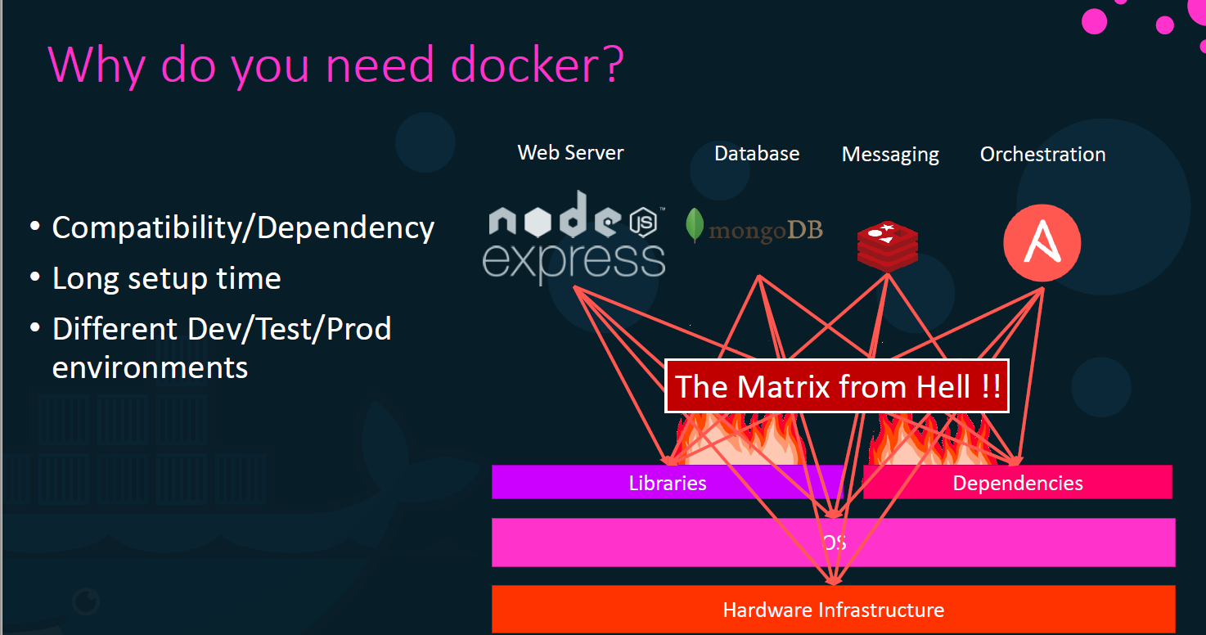
Docker Overview Concepts
Nagaraj manoharan

Slide 4
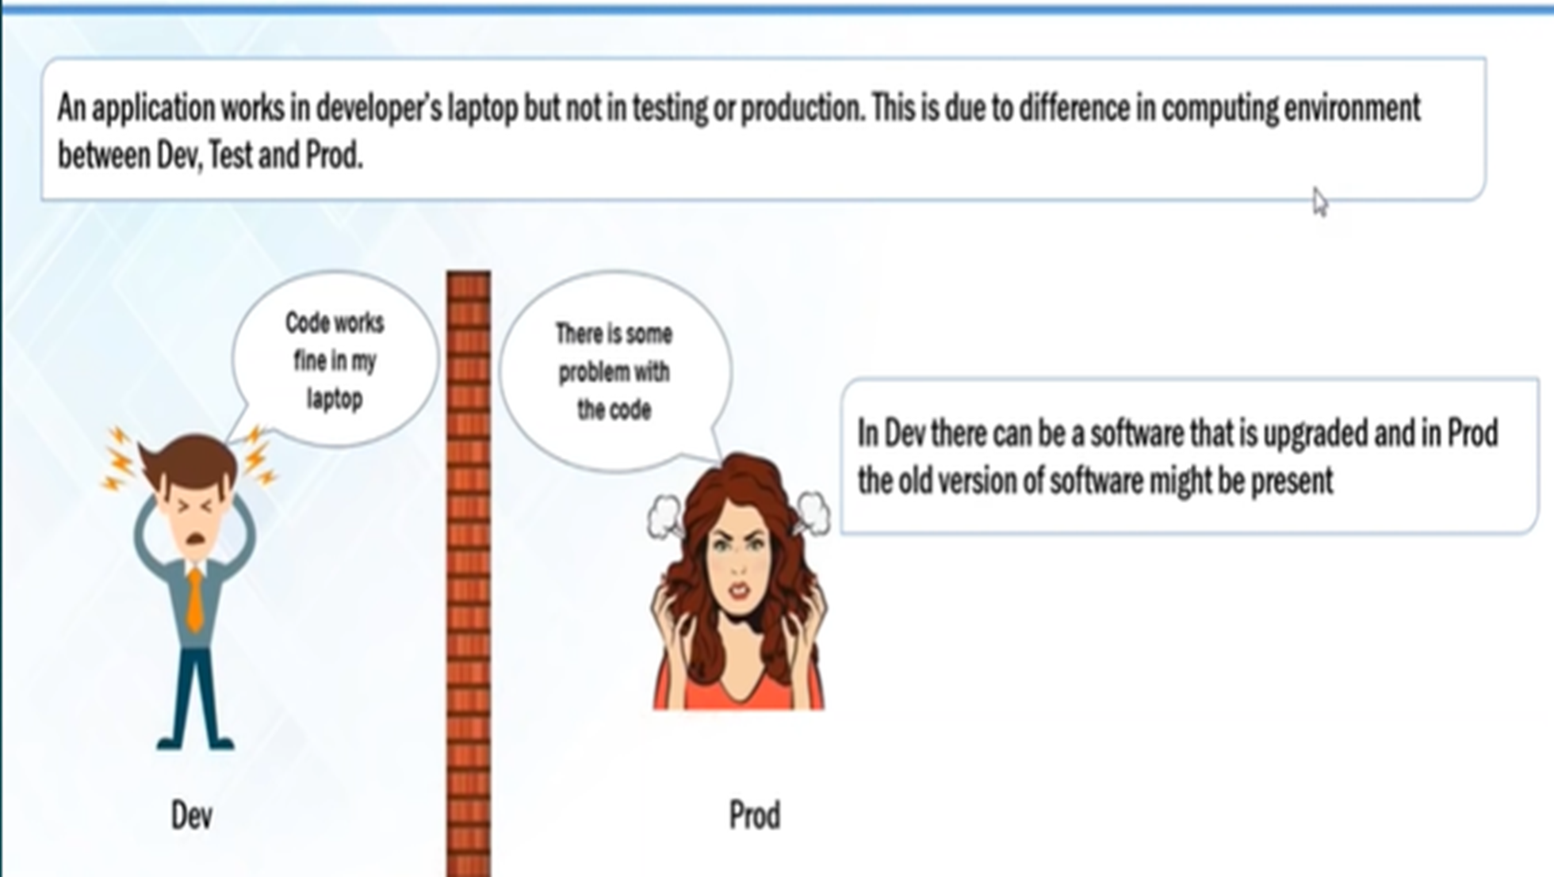
Docker Overview Concepts
Nagaraj manoharan

Slide 5
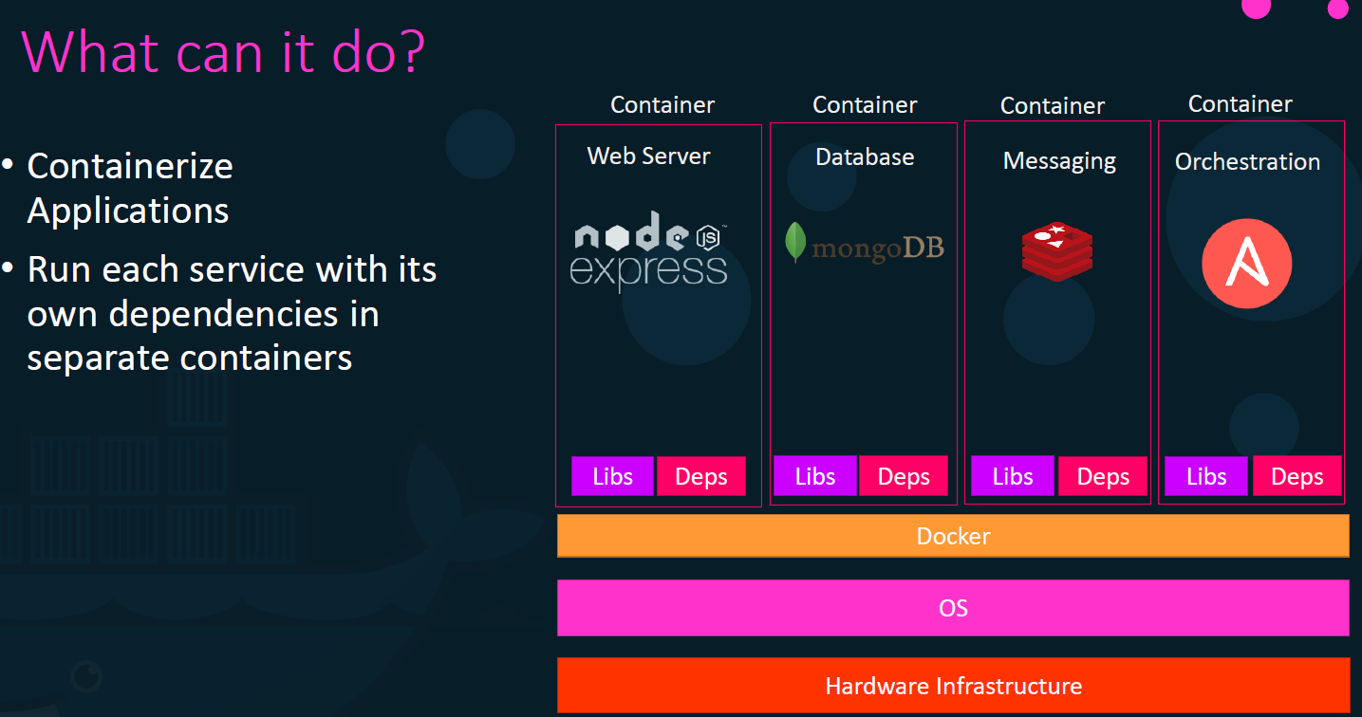

Slide 6

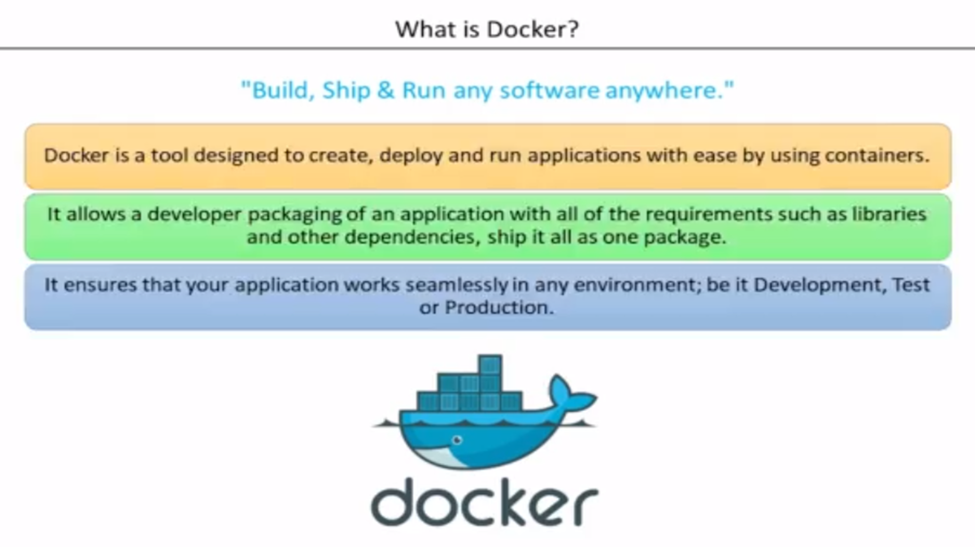
Title of the presentation with a picture [Tahoma Bold 40 pt]
Subtitle of the presentation in 1 or several lines [Tahoma regular 14 pt]
Notes:
Docker is a lightweight ,stand-alone, executable package of a piece of software that includes everything needed to run it : code ,run time, system tools, system libraries ,settings . These are ideal to run all major linux , windows ,VM or any cloud .Containers isolate application from one another and from the underlying infrastructure ,Hence secure to use .

Slide 7
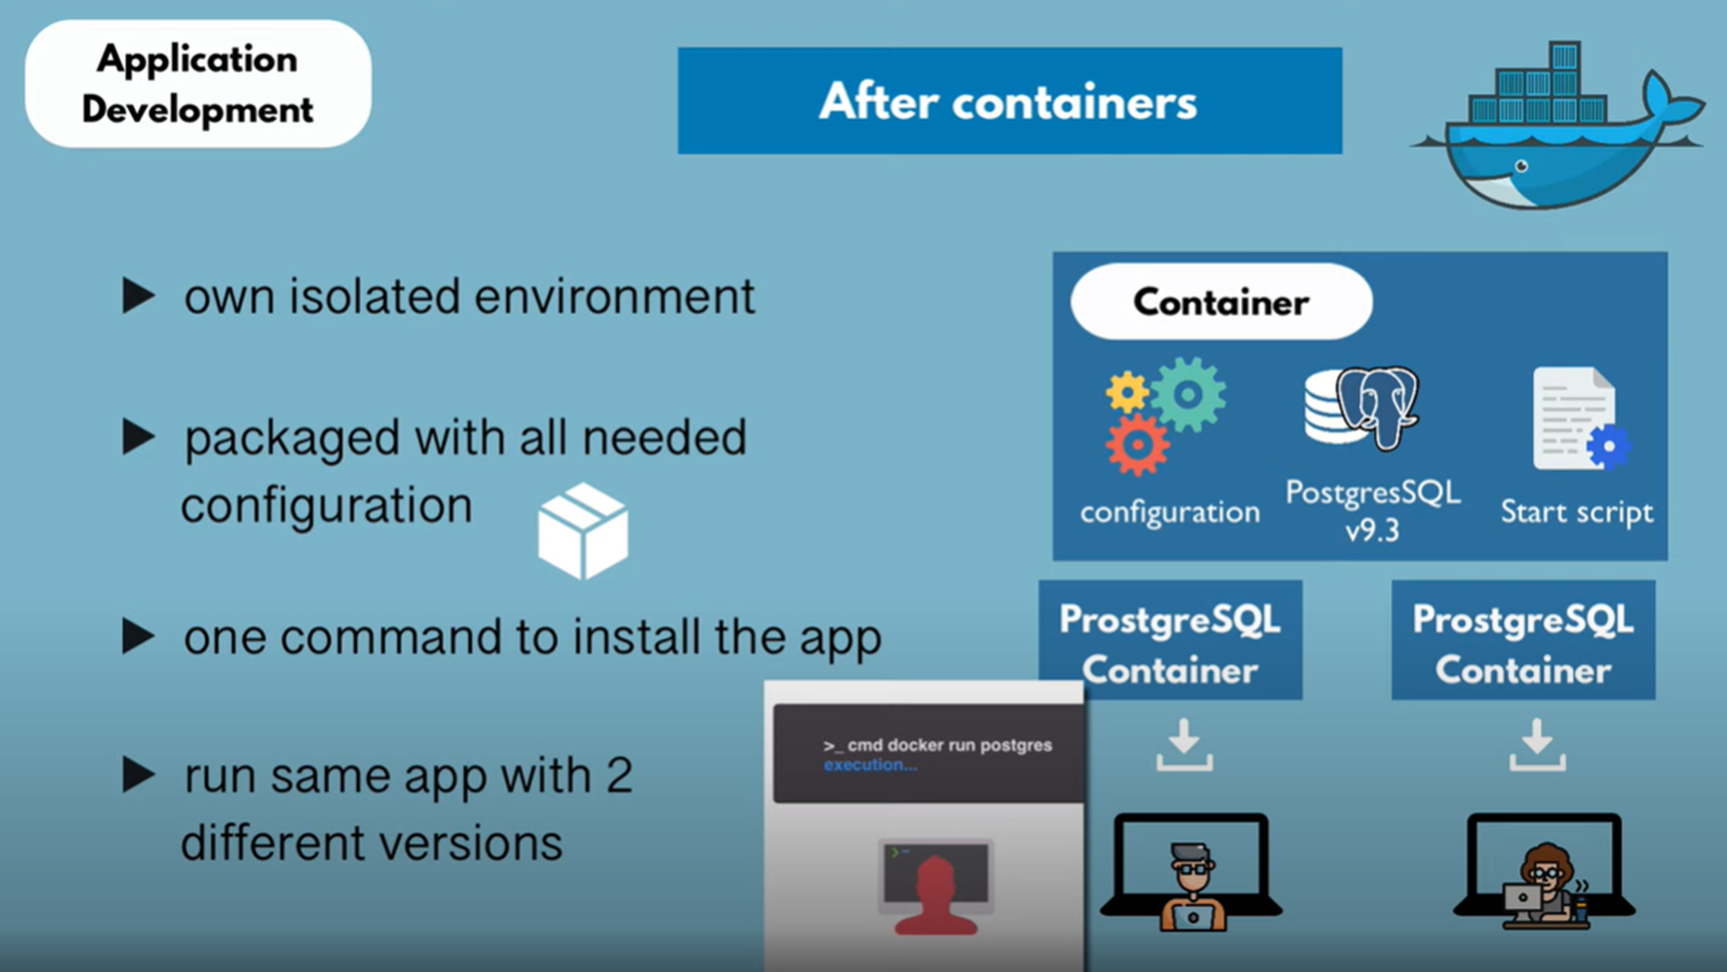
Docker Overview Concepts
Nagaraj manoharan

Slide 8
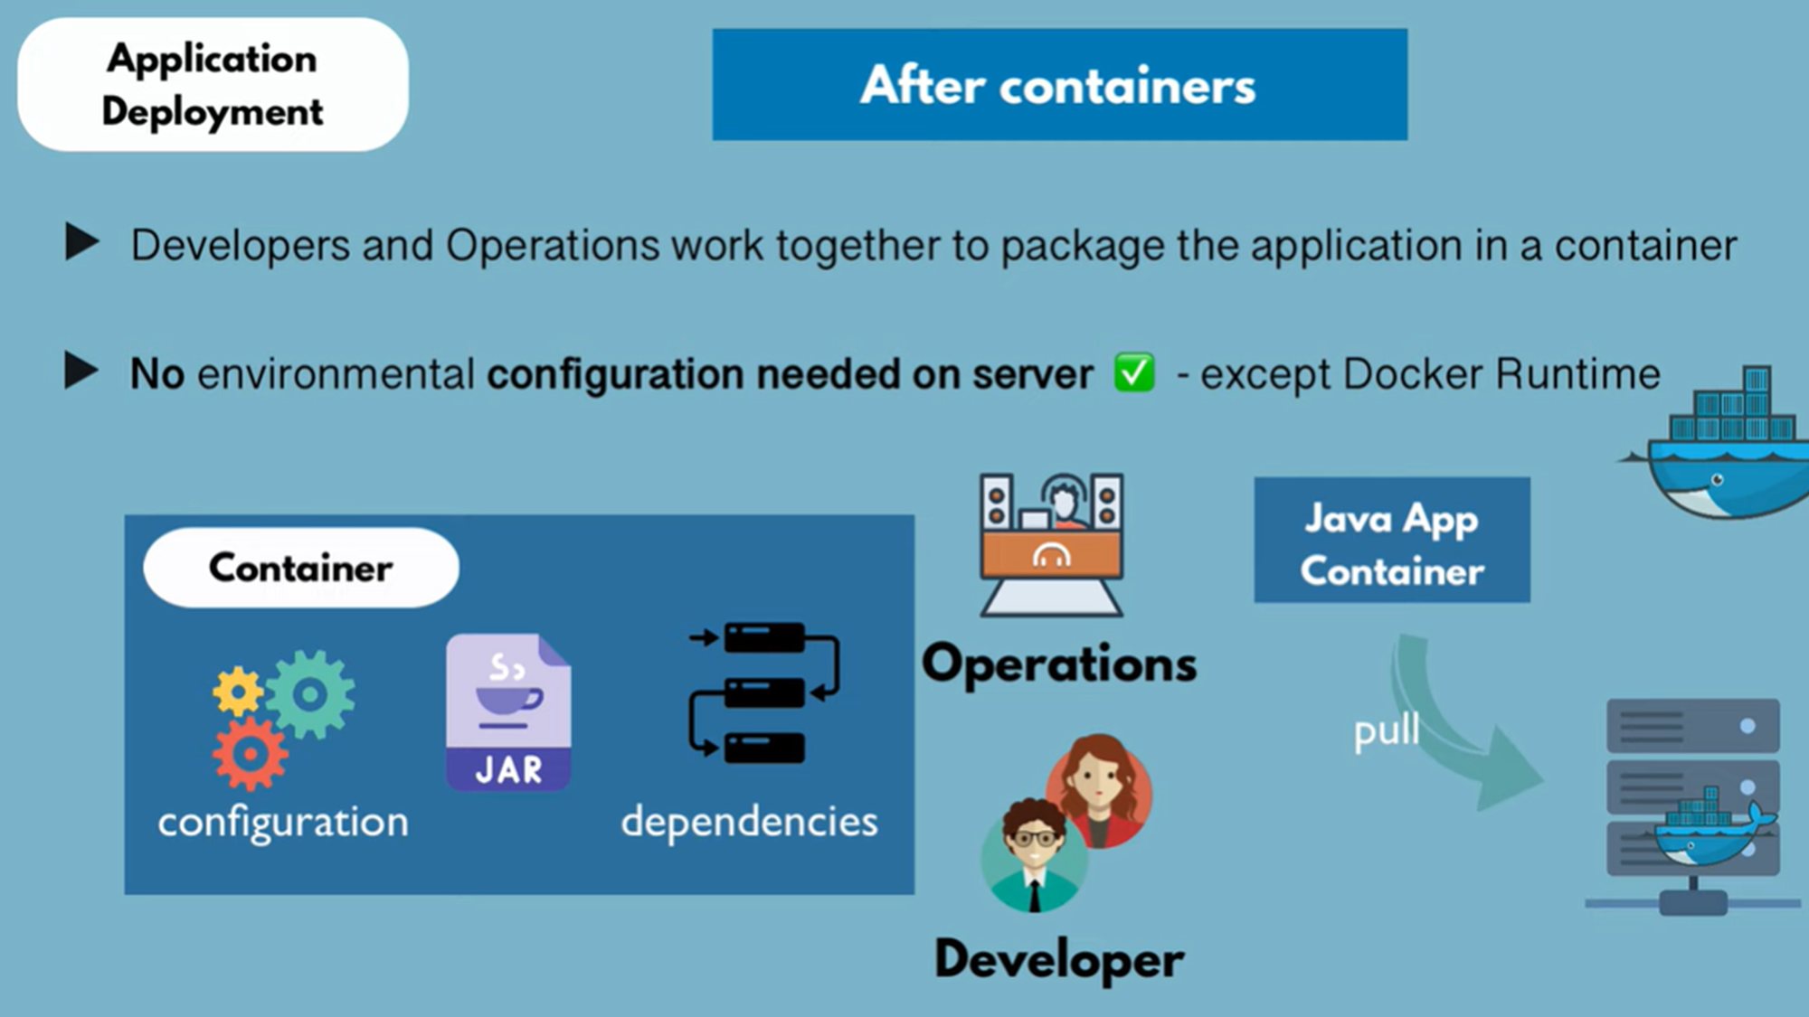

Slide 9
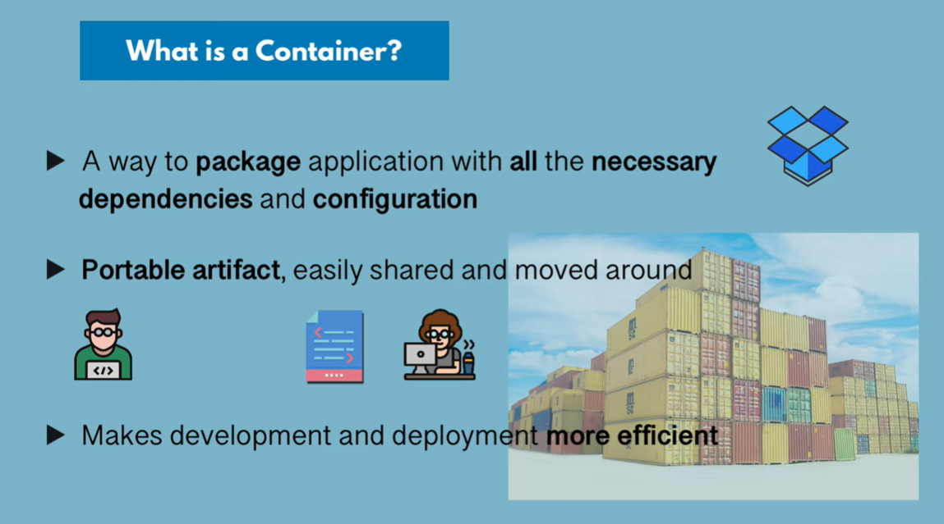
Docker Overview Concepts
Nagaraj manoharan
Notes:
Docker container is next step to VM .
Container image is a light weight, stand-alone, executable package of a piece of software that includes everything needed to run it : code ,runtime , system tools ,system libraries, settings.
Available for both Linux and windows-based app, containerized software will run the same , regardless of the environment .
Template/Blueprint to create a environment of your choice .Contains everything which your app needs in read only mode .
The Runtime instance of this image is usually called container.

Slide 10
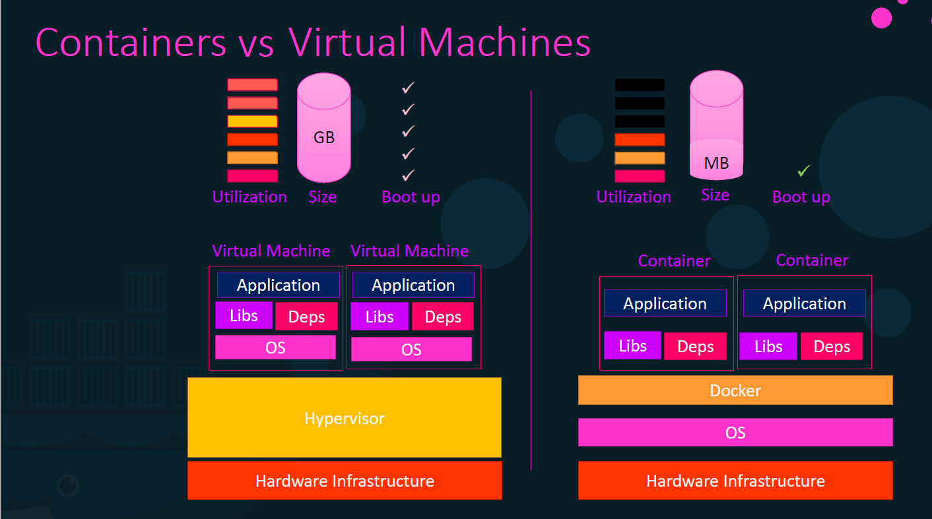
Notes:
Docker container is next step to VM .
Docker is a lightweight ,stand-alone, executable package of a piece of software that includes everything needed to run it : code ,run time, system tools, system libraries ,settings . These are ideal to run all major linux , windows ,VM or any cloud .Containers isolate application from one another and from the underlying infrastructure ,Hence secure to use .

Slide 11
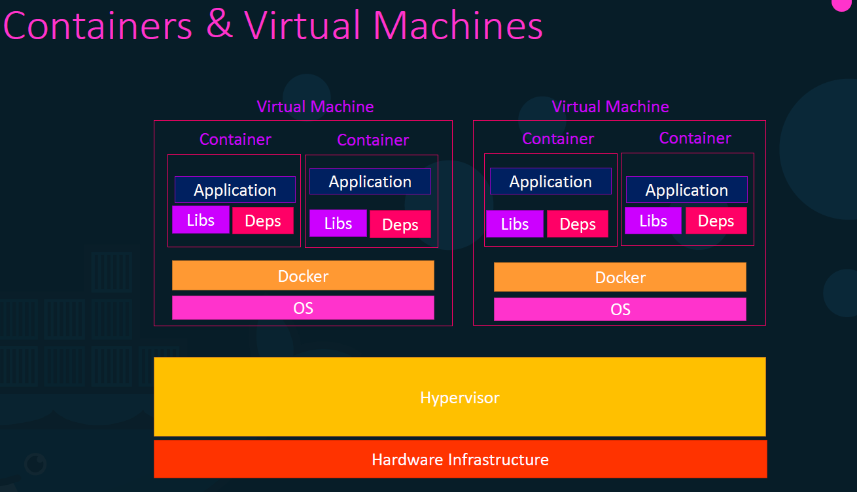

Slide 12
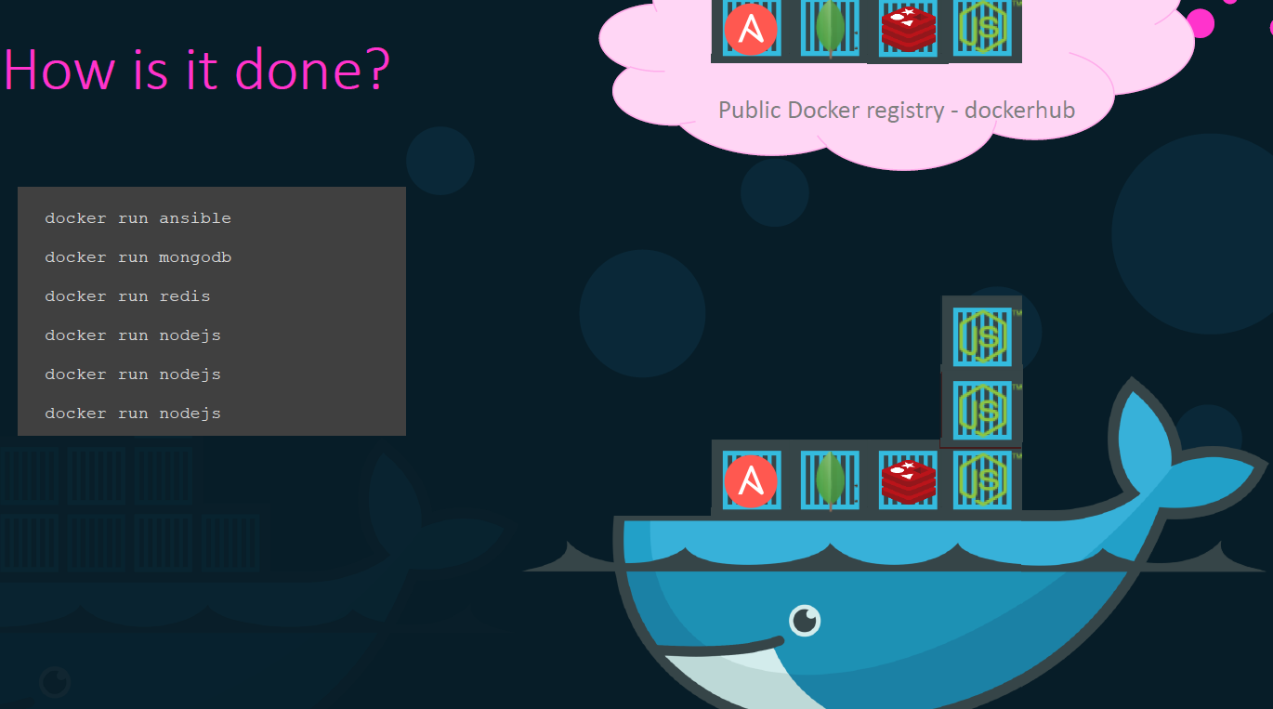

Slide 13
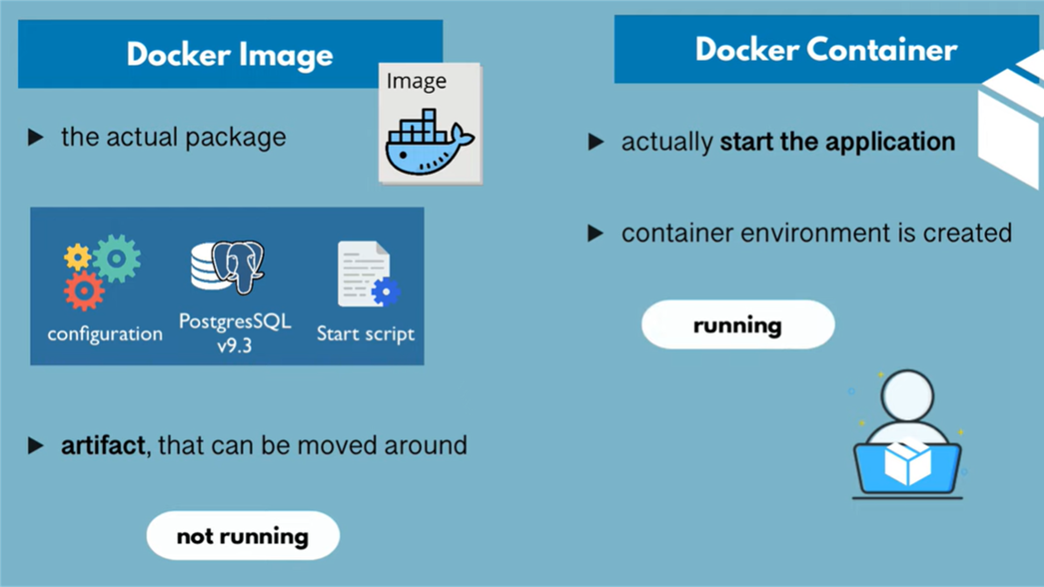

Slide 14
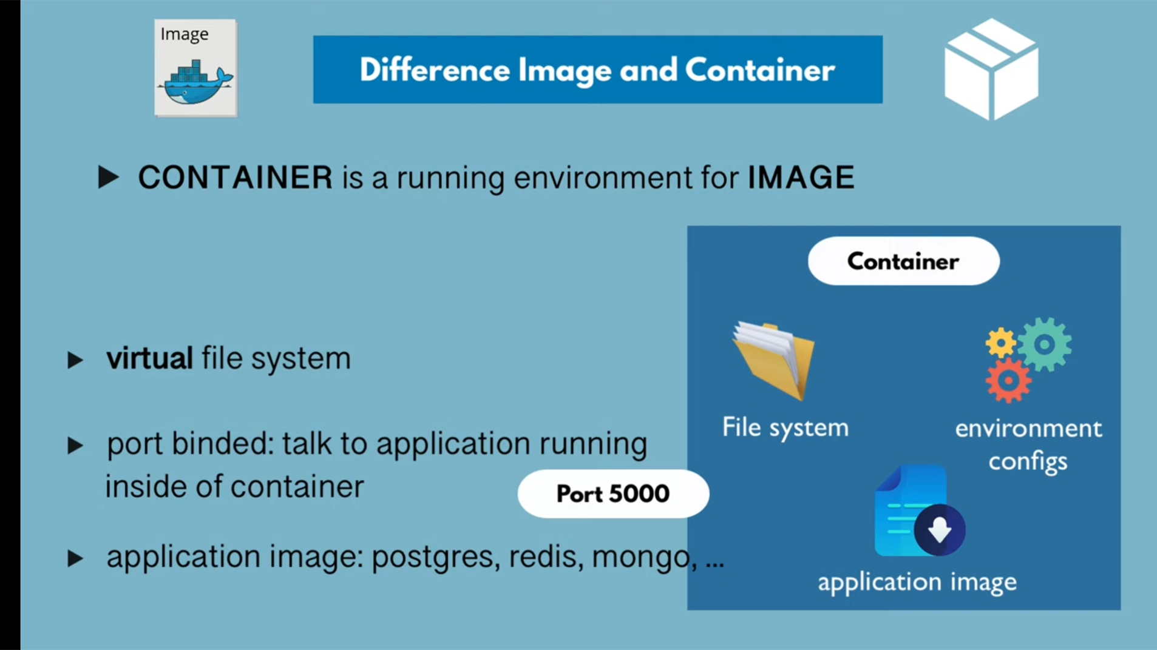

Slide 15
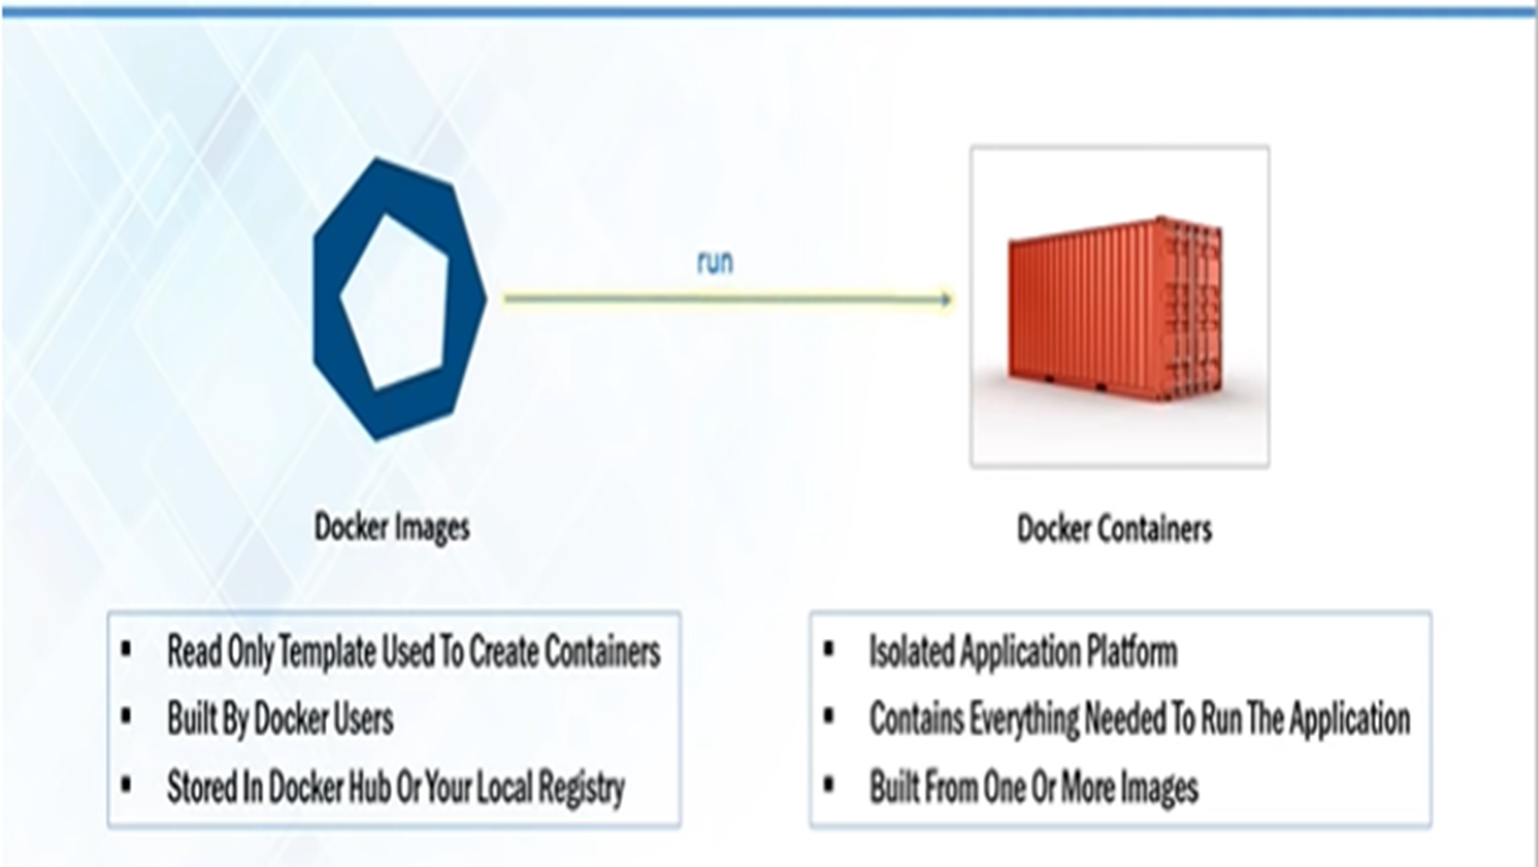
Notes:
Image is a static file by running which you get a container .
Image : The basis of docker container .The content at rest .
Container : Image when it’s running .The standard unit for app service .
Engine : The software that executes command for containers .Can be clustered together .Networking and volumes are part of this engine .

Slide 16
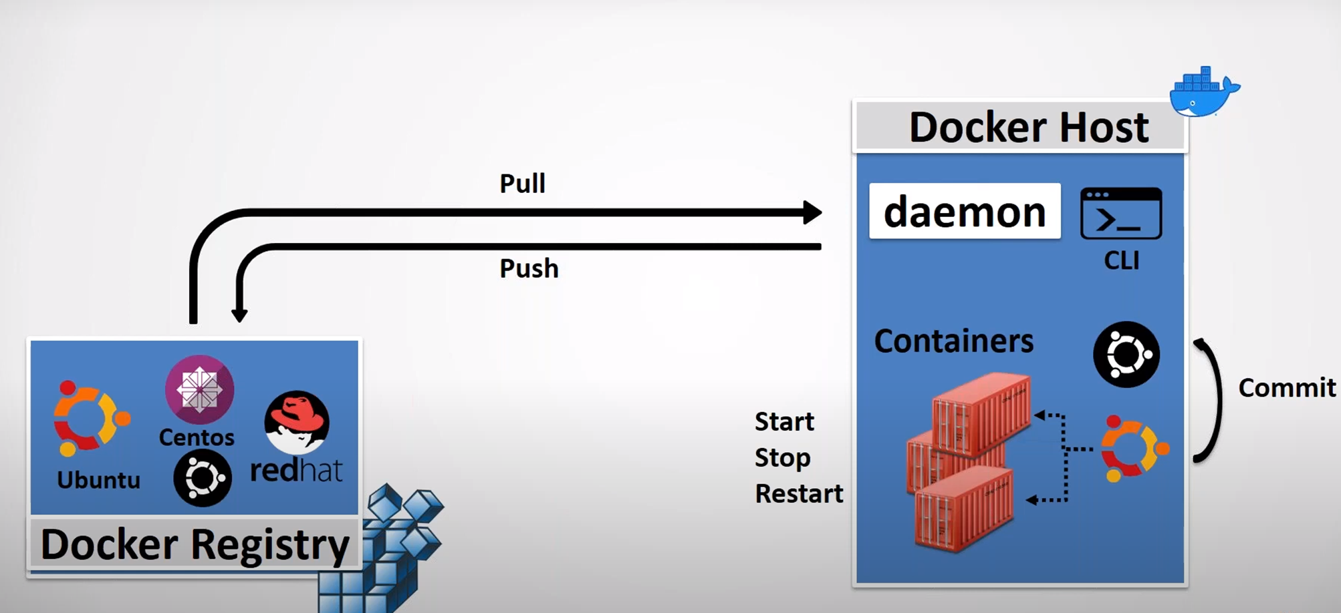
DOCKER SYSTEM
Notes:
Containers are standard packaging of software and its dependencies which is isolated from each other and work independently on any OS .
Registry : stores ,distributes and manages docker images .
Control Plane : Management plane for container and cluster orchestration .

Slide 17
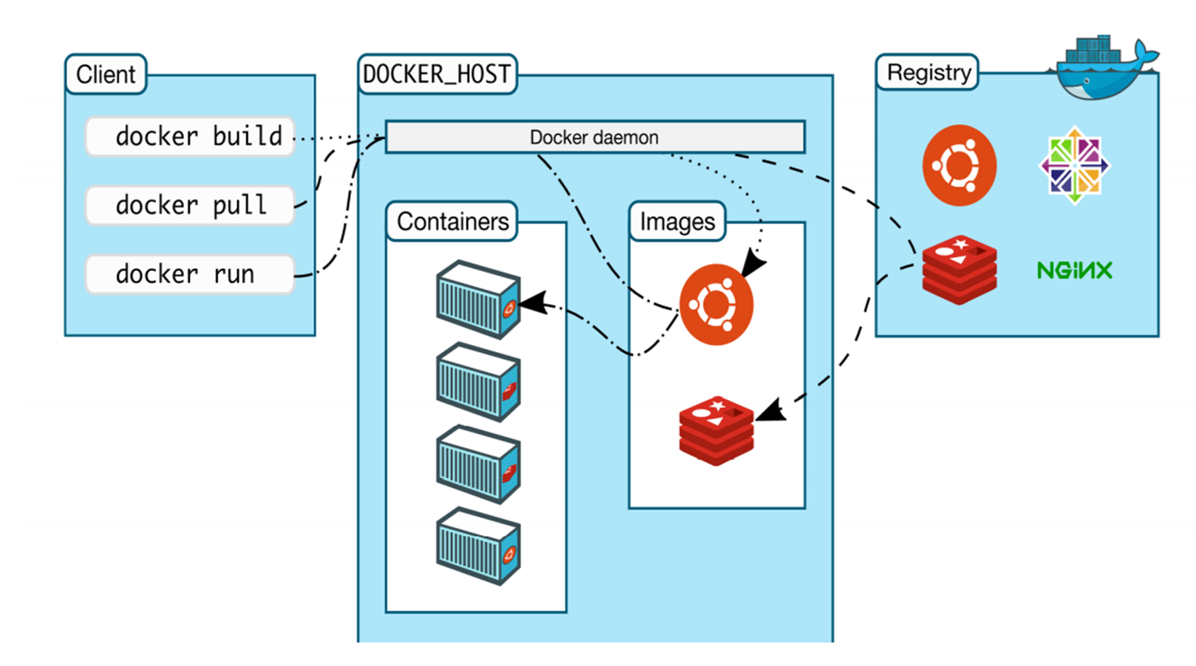
Docker Architecture
Notes:
Docker architecture
Docker uses a client-server architecture. The Docker client talks to the Docker daemon, which does the heavy lifting of building, running, and distributing your Docker containers. The Docker client and daemon can run on the same system, or you can connect a Docker client to a remote Docker daemon. The Docker client and daemon communicate using a REST API, over UNIX sockets or a network interface. Another Docker client is Docker Compose, that lets you work with applications consisting of a set of containers.

Slide 18
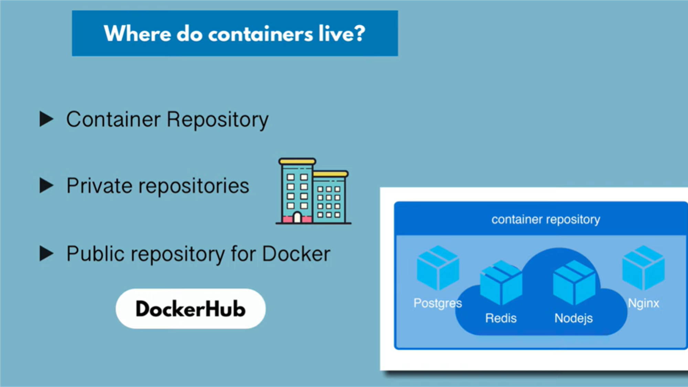

Slide 19
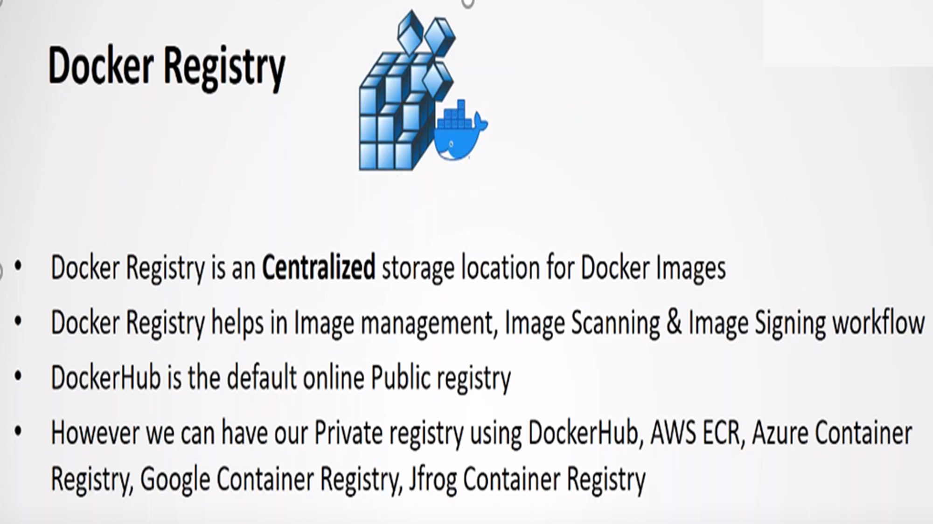

Slide 20
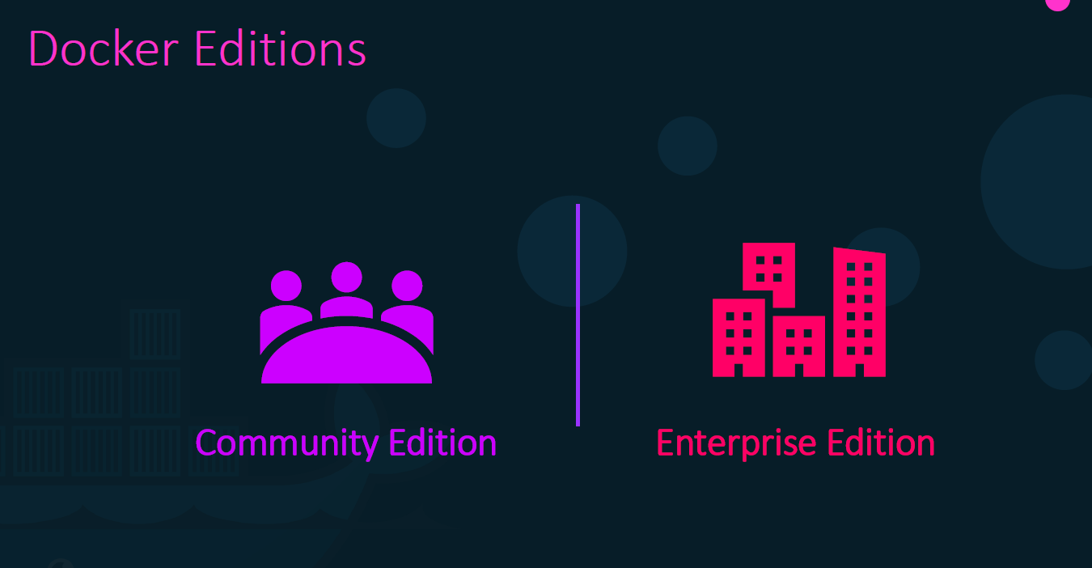
Notes:
Docker CE is a free and open source containerization platform. It is a rebranded version of the Docker open source solution that has been freely available since the launch of Docker in 2013.
CE can run on Windows 10 and Mac, on Azure and AWS, as well as CentOS, Debian, Fedora, and Ubuntu. CE can be downloaded directly from the Docker Store.
Docker EE, on the other hand, is a premium version of CE. Docker EE is an integrated, fully supported, and certified container platform that runs on Red Hat Enterprise Linux (RHEL), SUSE Linux Enterprise Server (SLES), Oracle Linux, Ubuntu, Windows Server 2016, as well as Azure and AWS.

Slide 21


Slide 22
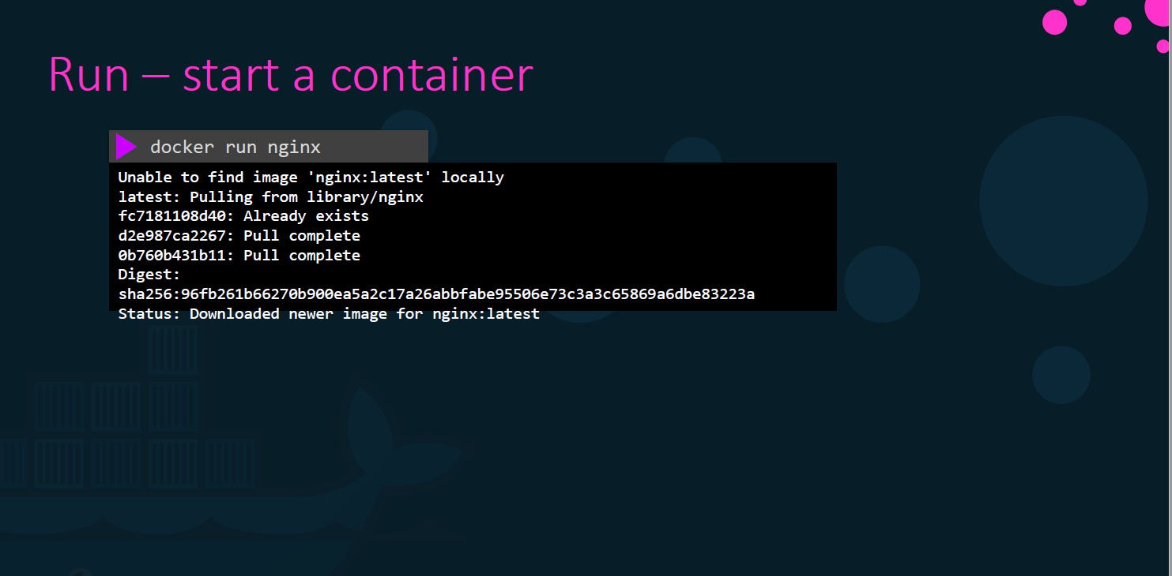

Slide 23
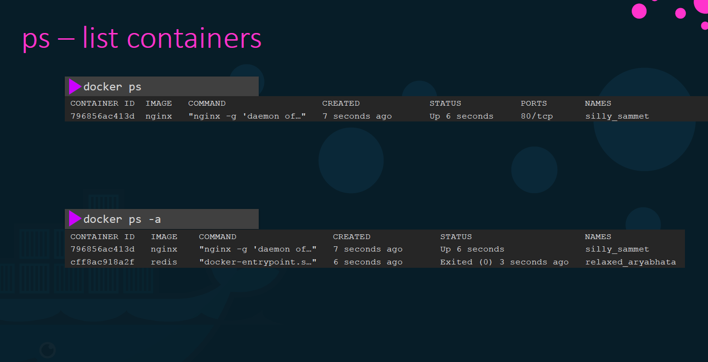

Slide 24
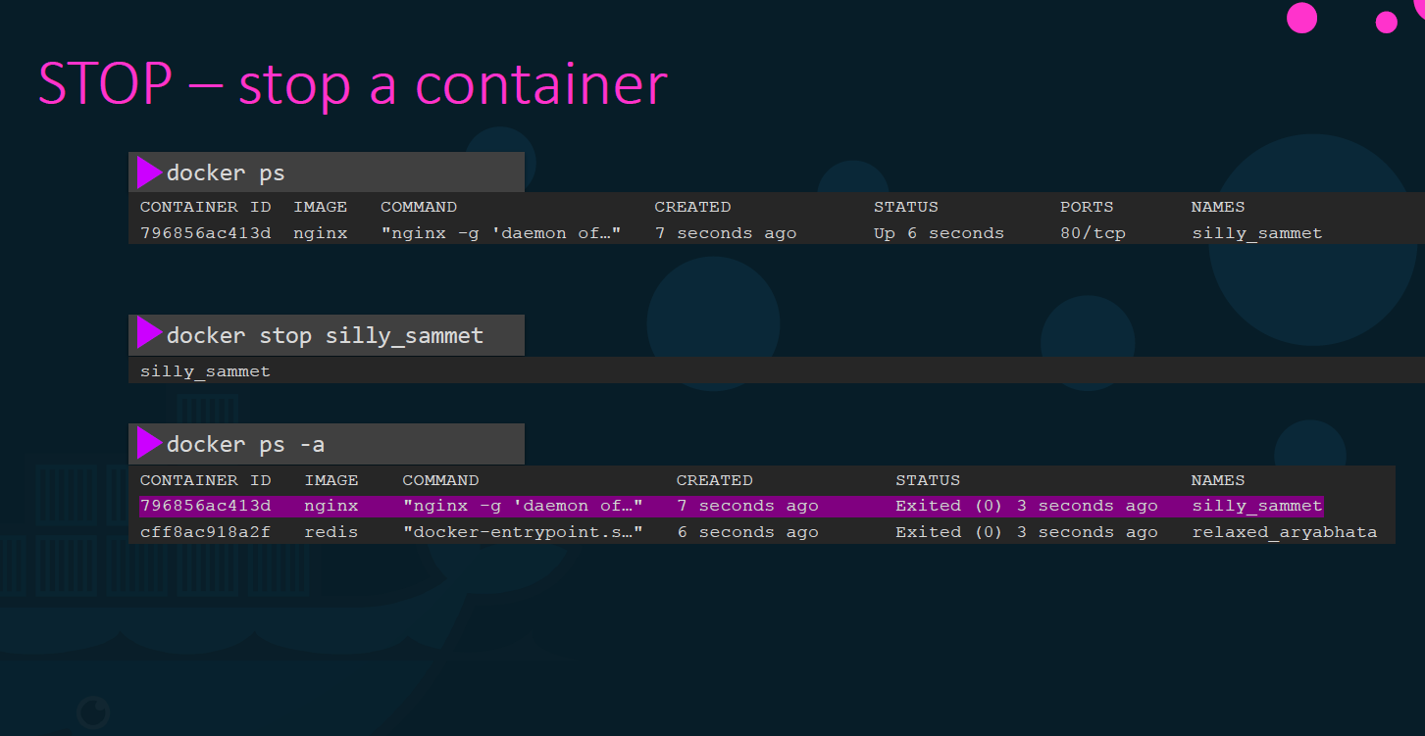

Slide 25
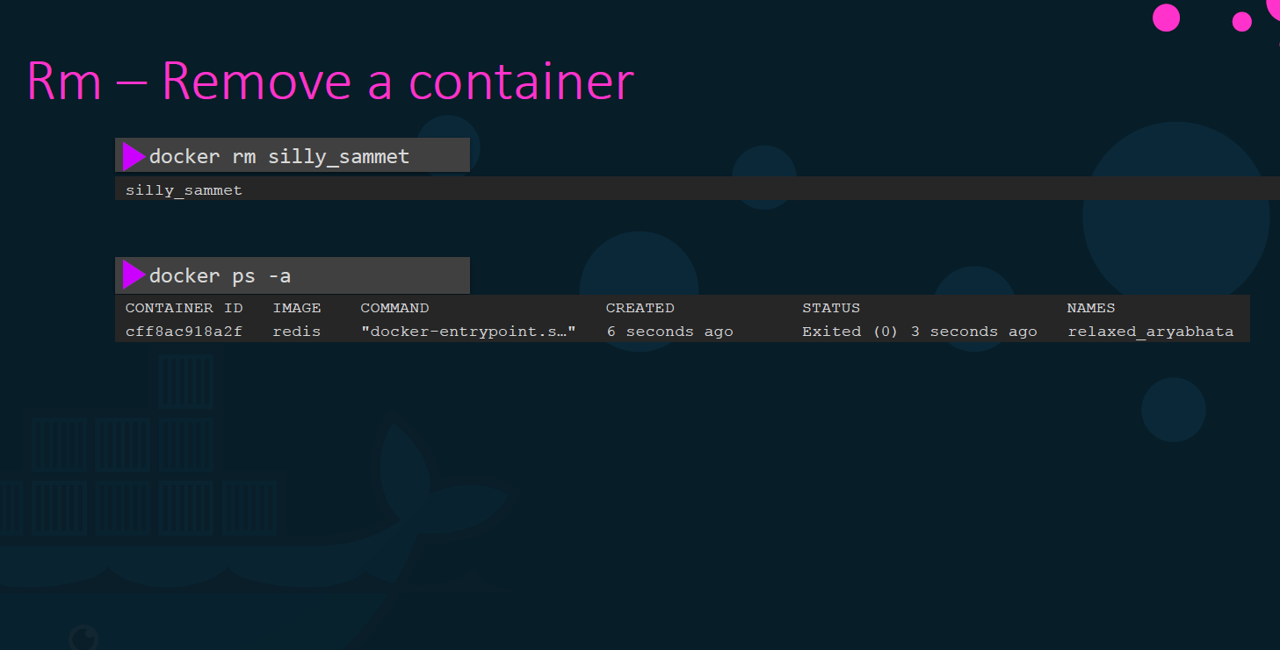

Slide 26
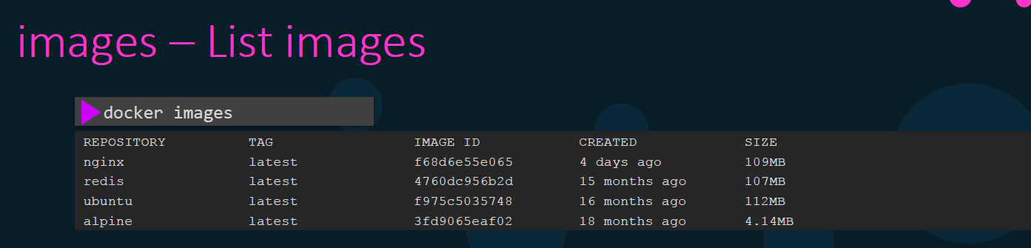
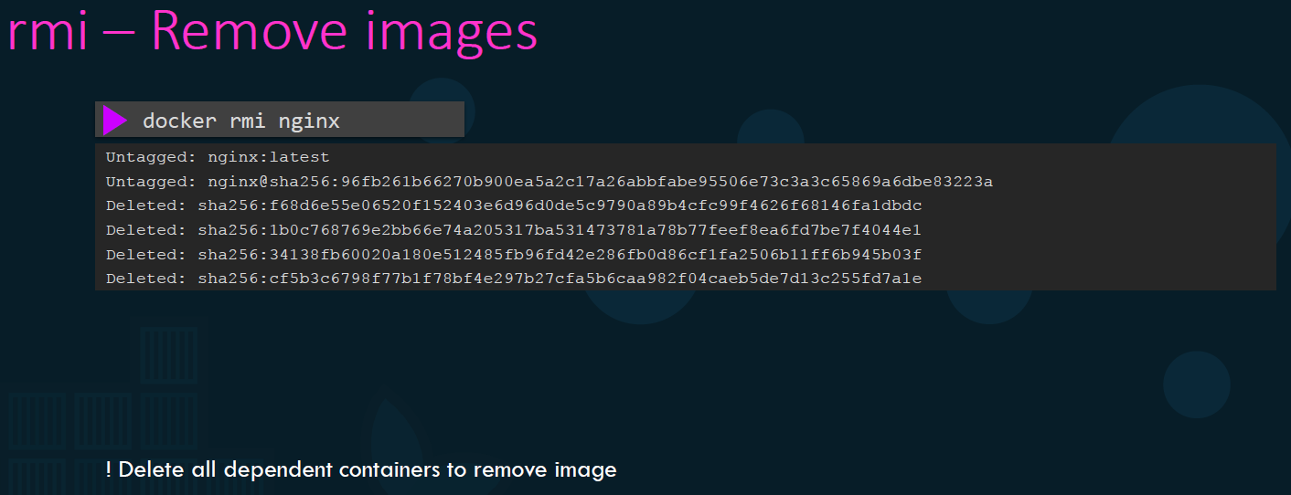

Slide 27
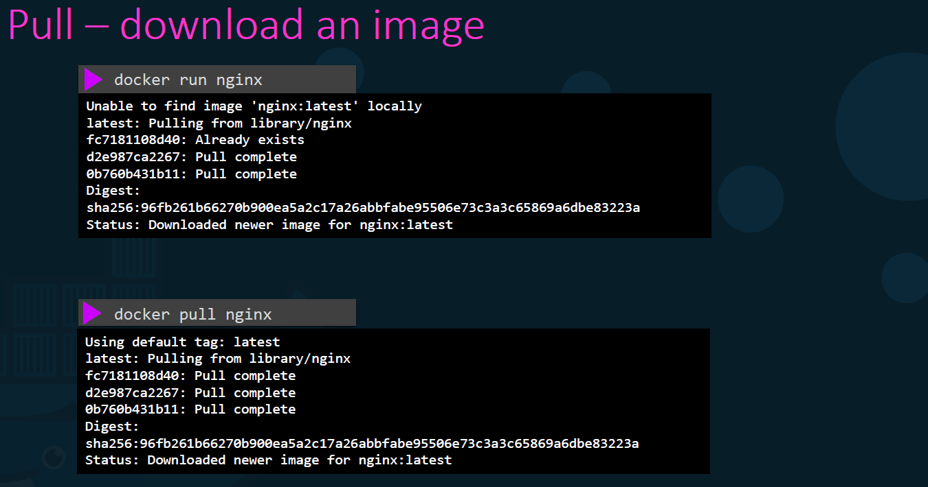

Slide 28
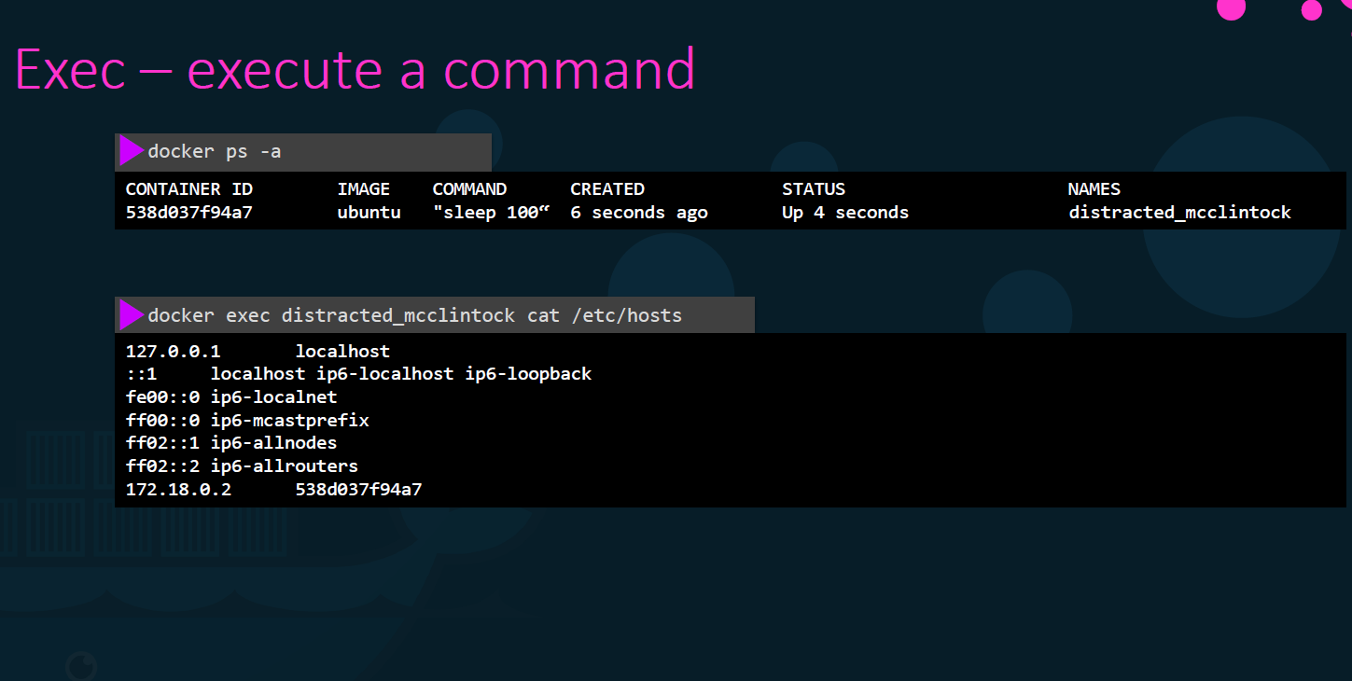

Slide 29
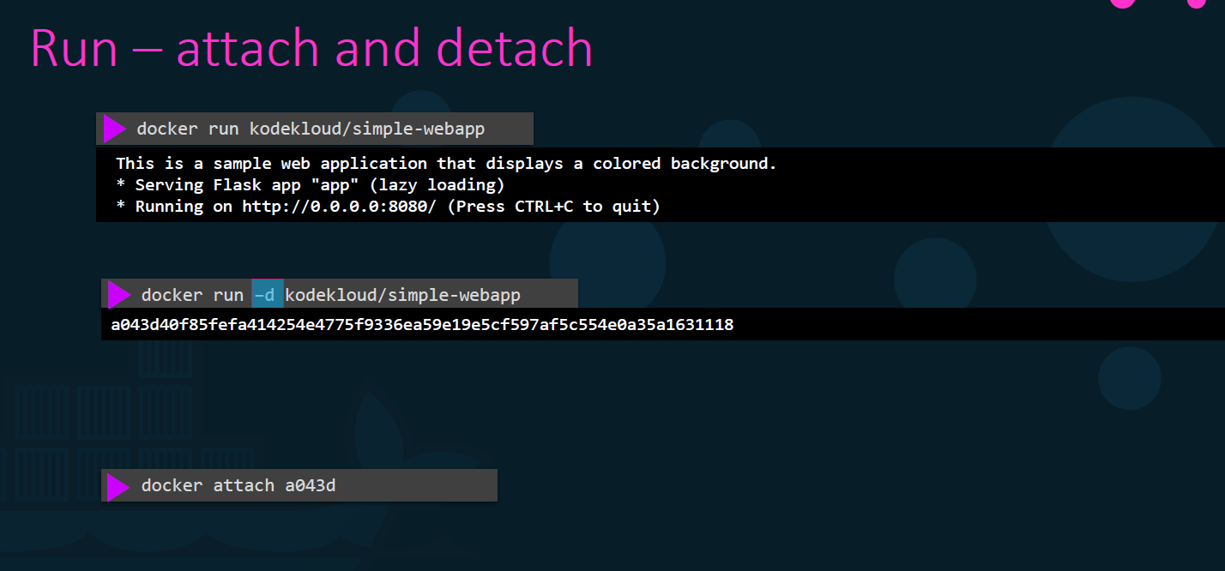

Slide 30
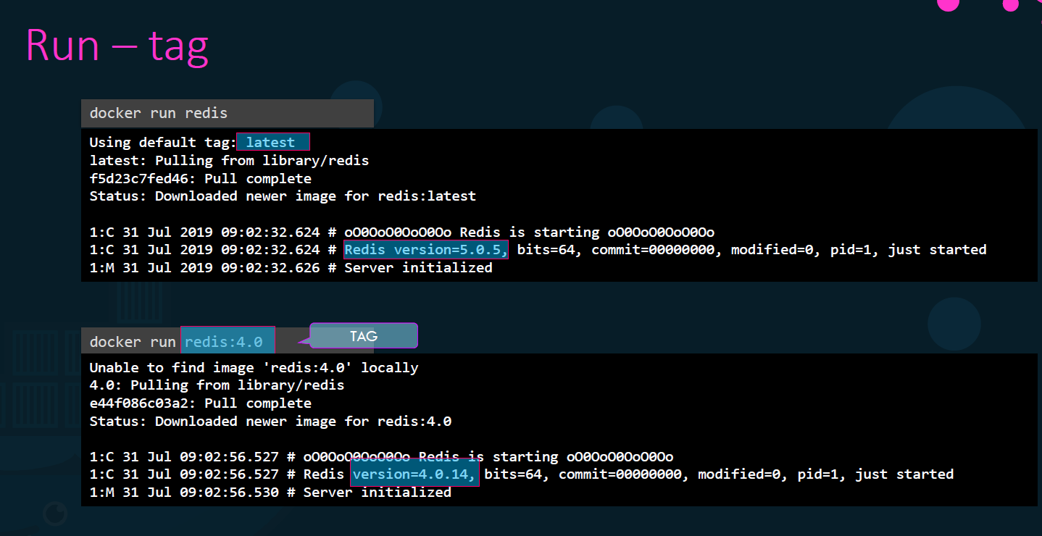

Slide 31
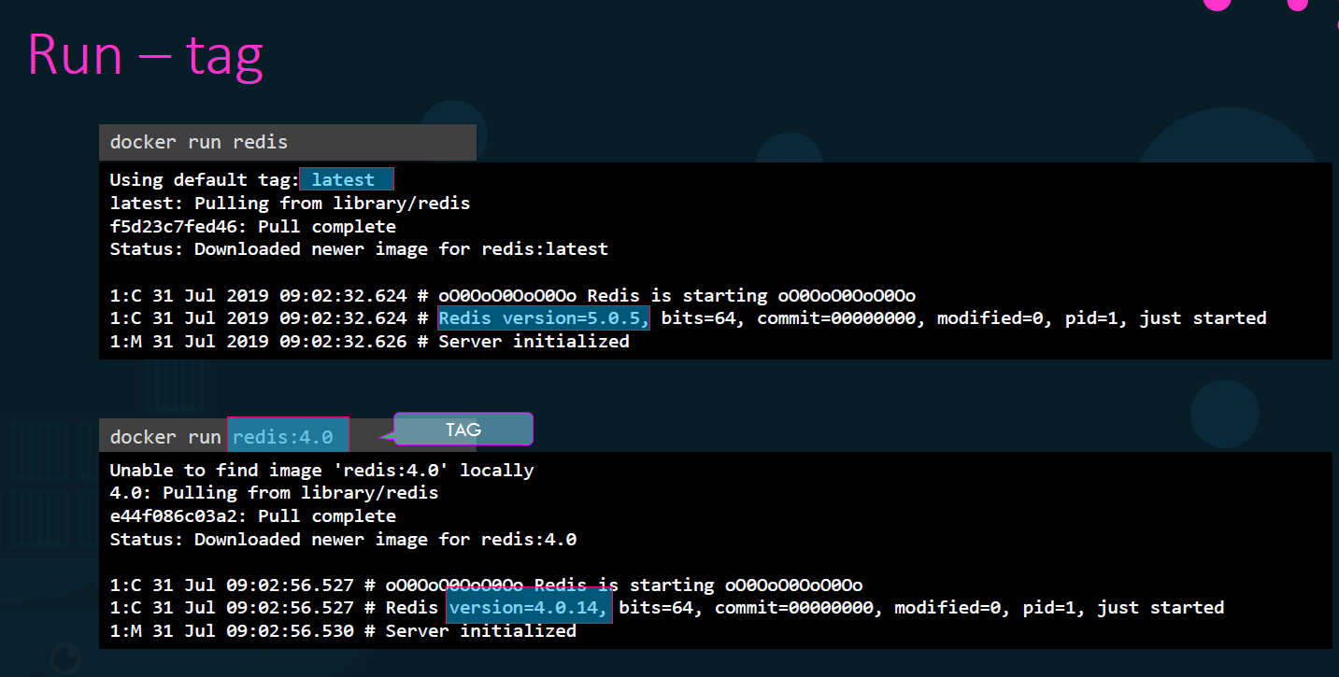

Slide 32
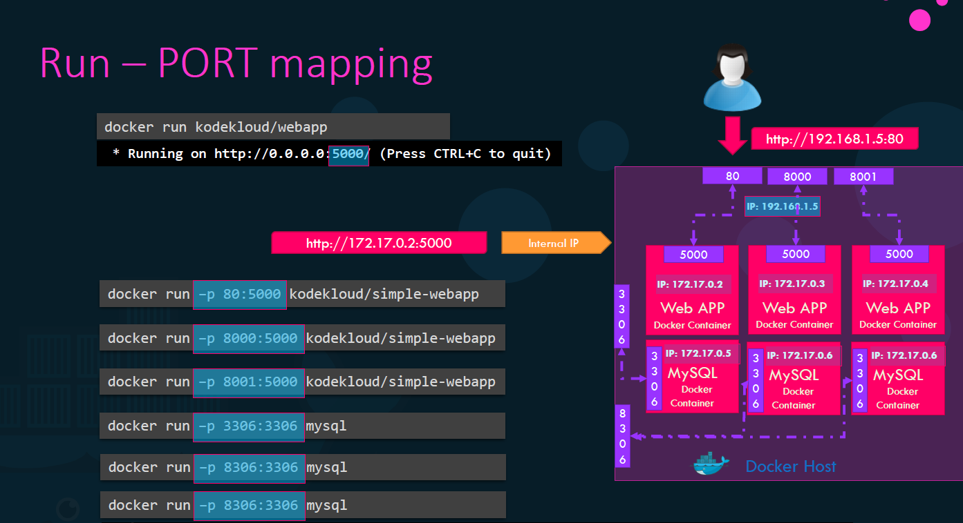

Slide 33
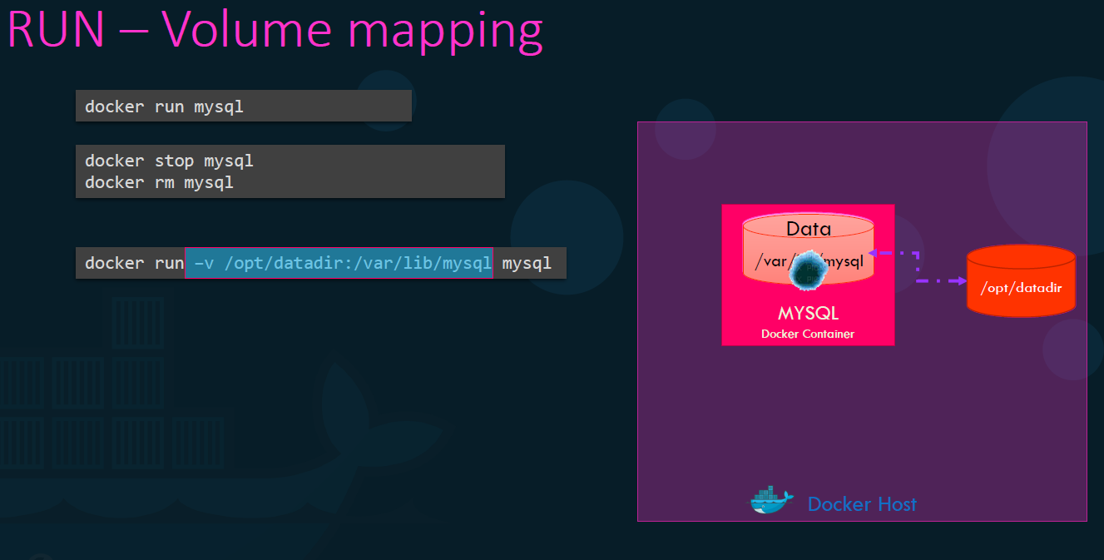

Slide 34
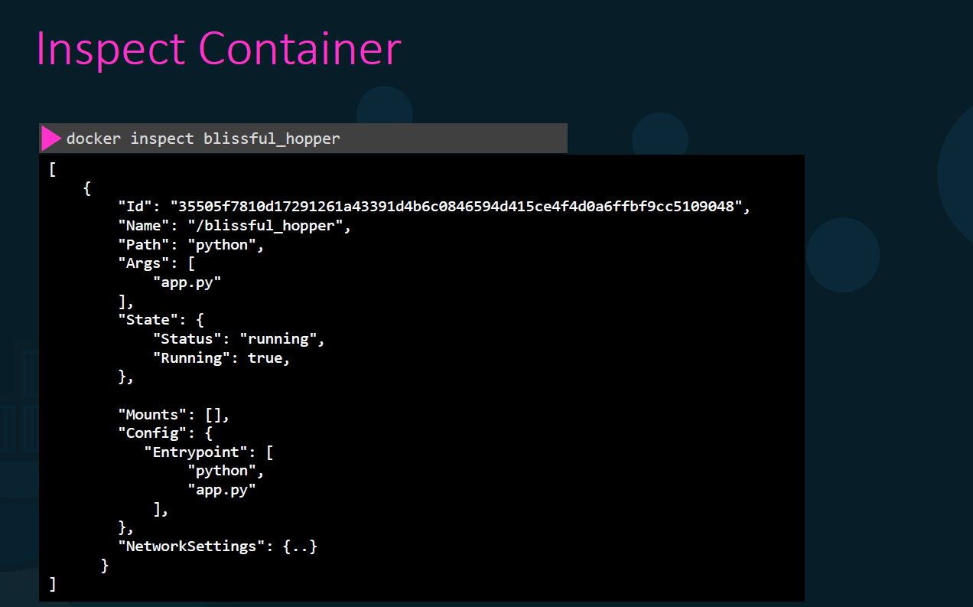

Slide 35


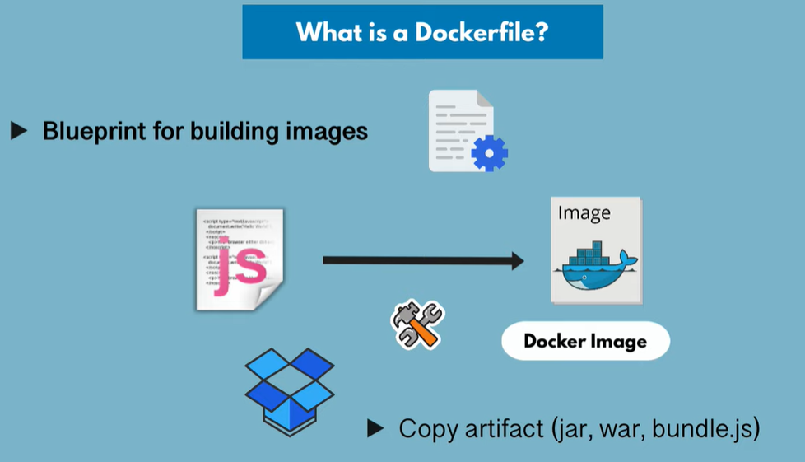




Slide 36
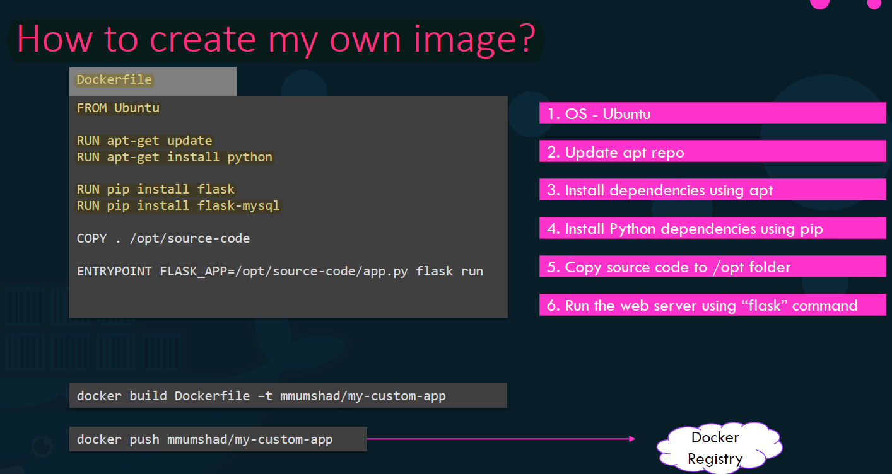

Slide 37
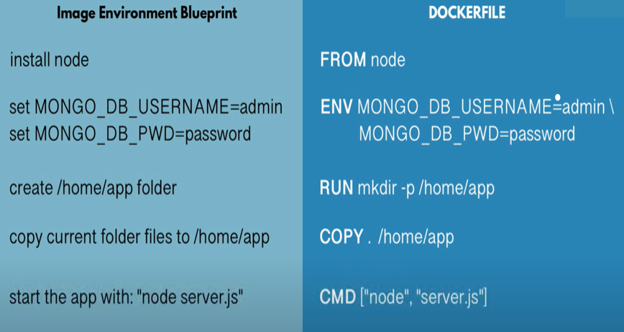
Notes:
Docker File : is a text document that contains all the commands a user could call on the command line to assemble an image .Using Docker build users can create an automated build that executes several commands-line instruction in sucession.
docker inspect <image-name>
From container:
-----------------
docker export <container id > > update.tar
docker import - newimage < update.tar
From Image:
-------------
docker save -o update1.tar newimage
docker rmi newimage
docker load < update1.tar
Docker file is a blueprint for building image
Keywords:
FROM : Talks about the base image
ENV : Optional as environment variables are defined here .
RUN - Execute any Linux command .Execution will happen inside the container .
COPY - Source can be local, and destination is inside container
CMD – Always part of docker file . Execute entry point Linux command .
Multiple RUN commands can be there but only one CMD command .
docker ps -a | grep my-app

Slide 38
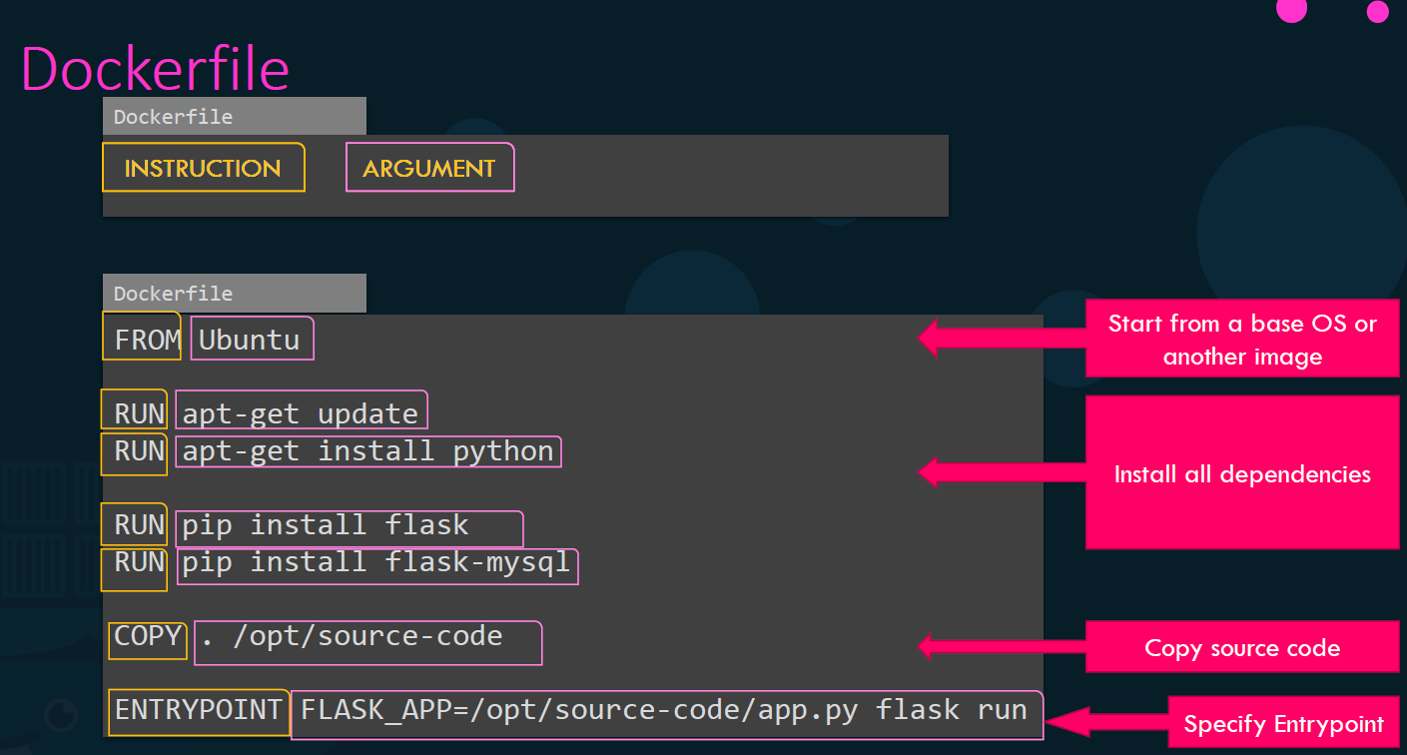

Slide 39
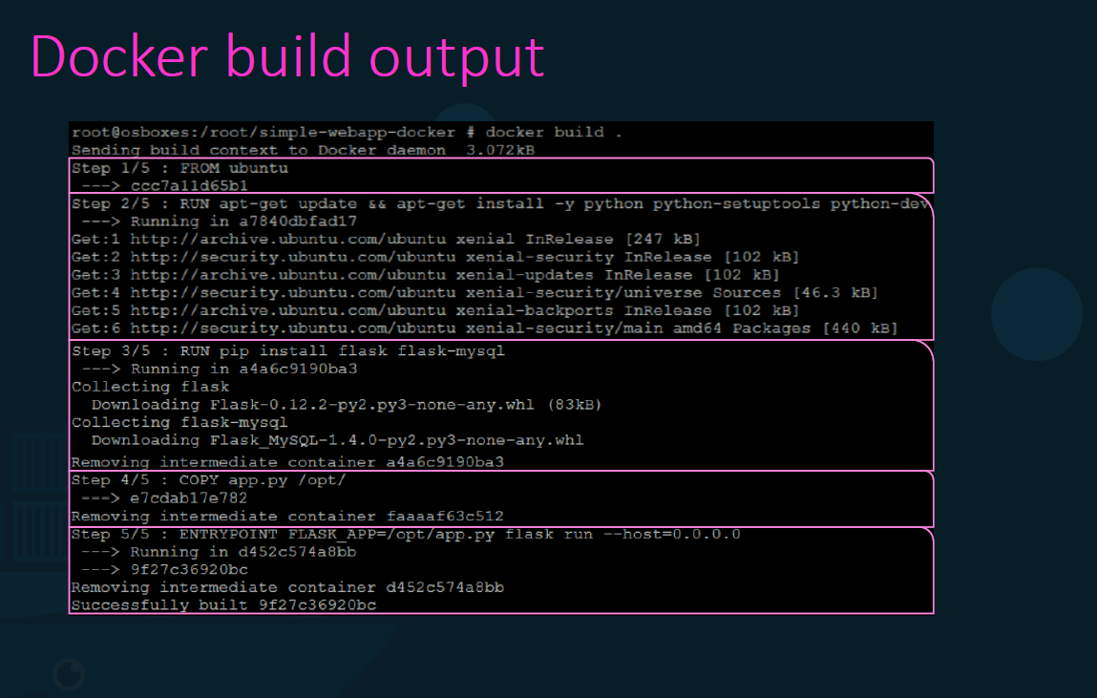

Slide 40
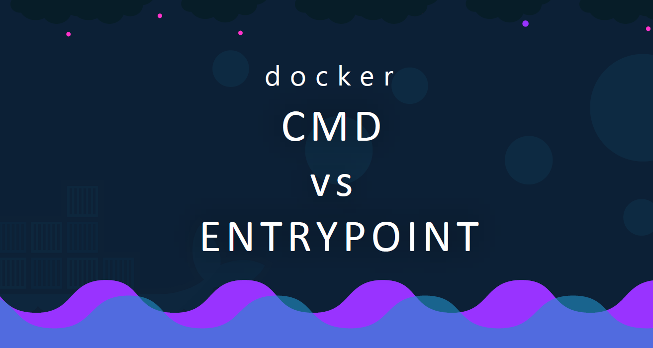

Slide 41
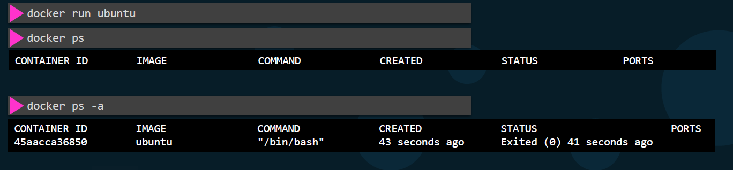


Slide 42
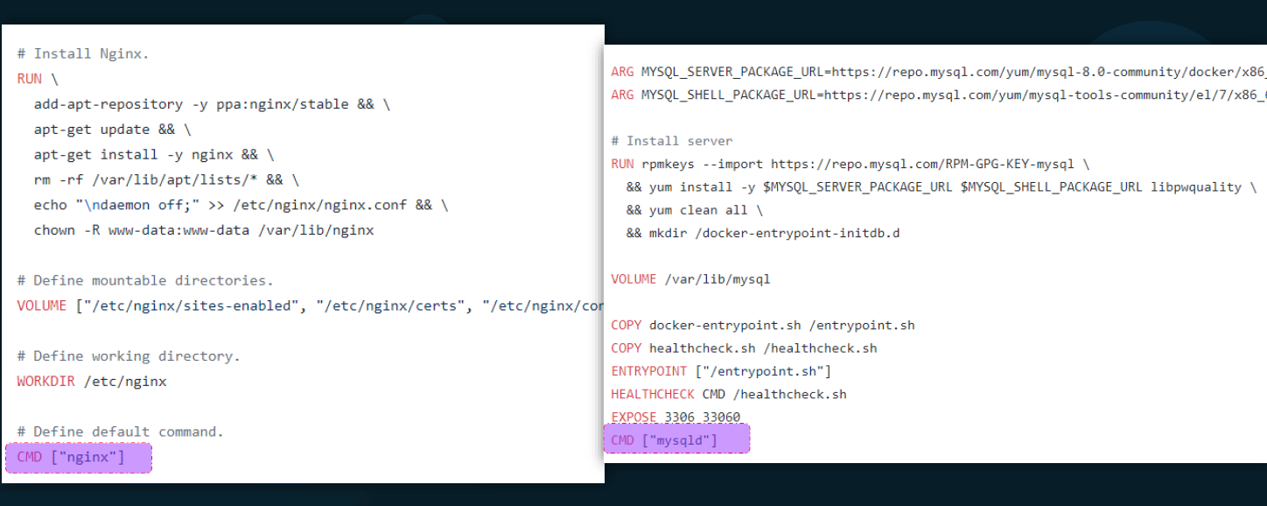

Slide 43
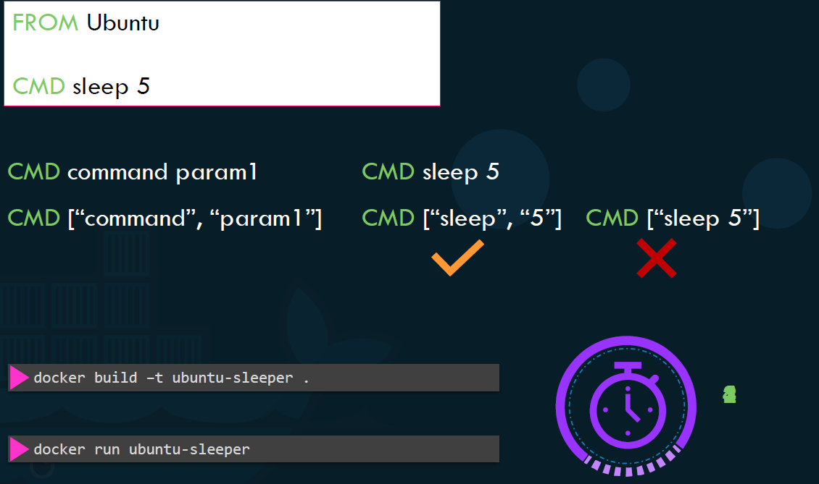

Slide 44
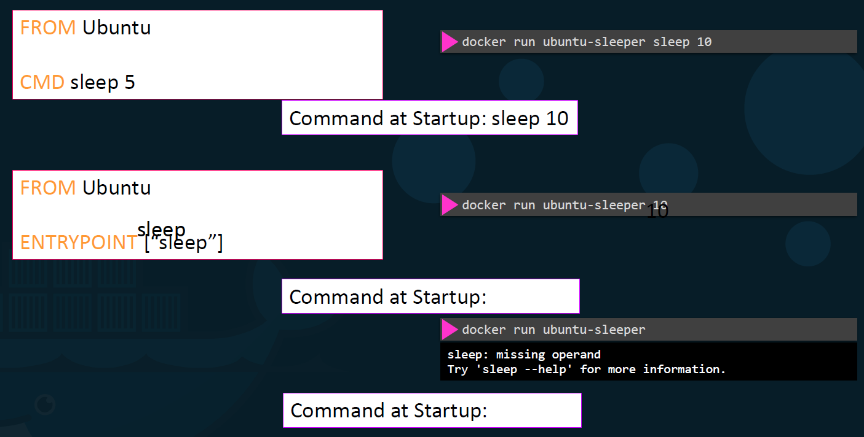

Slide 45
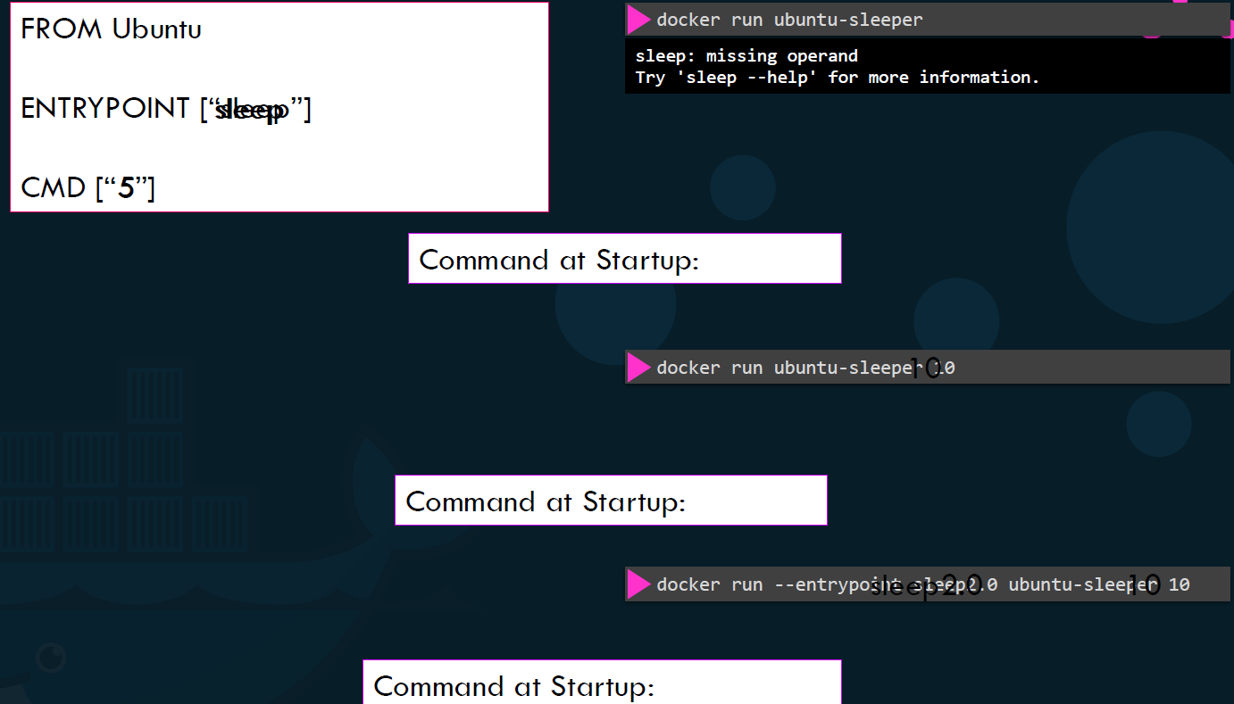

Slide 46
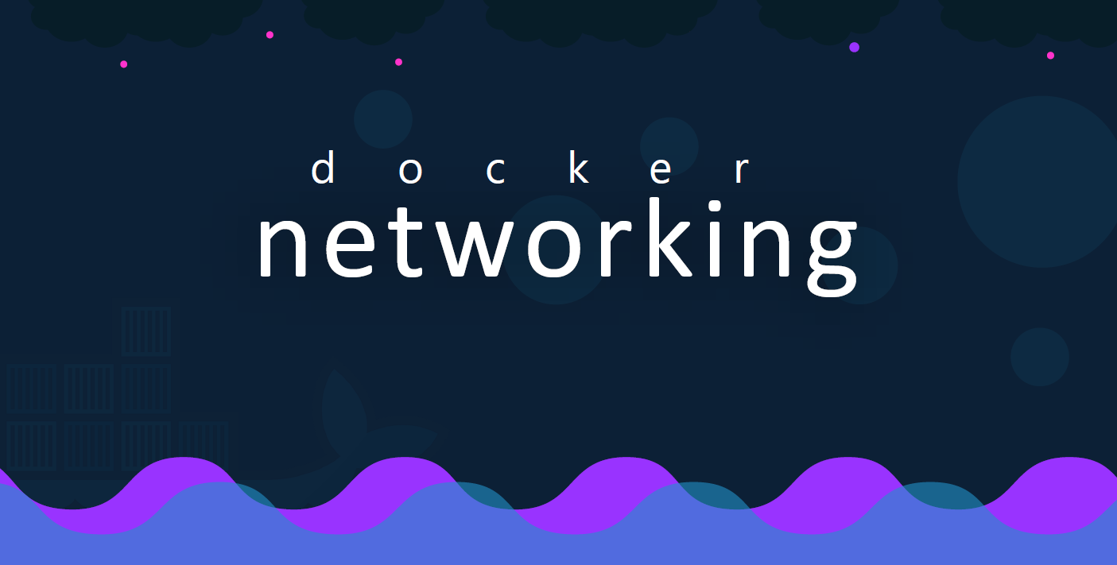

Slide 47
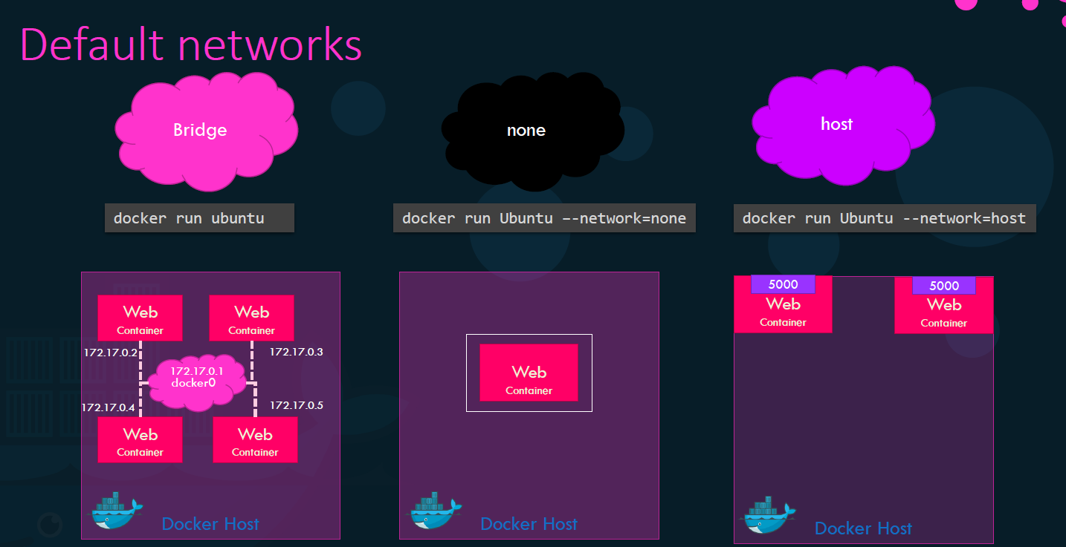

Slide 48
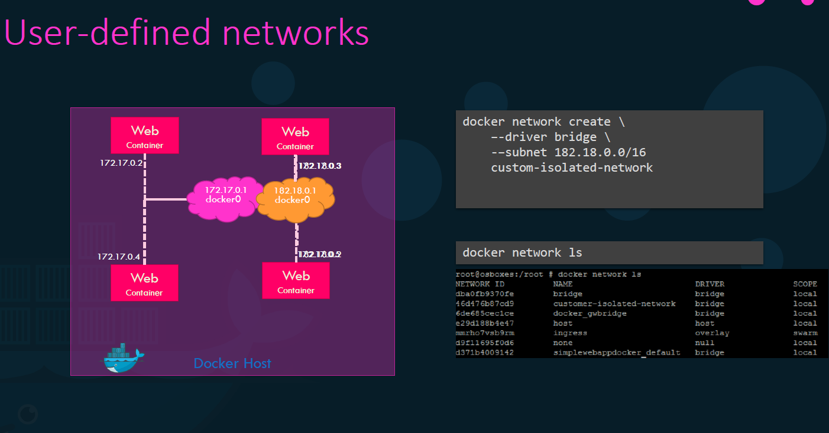

Slide 50
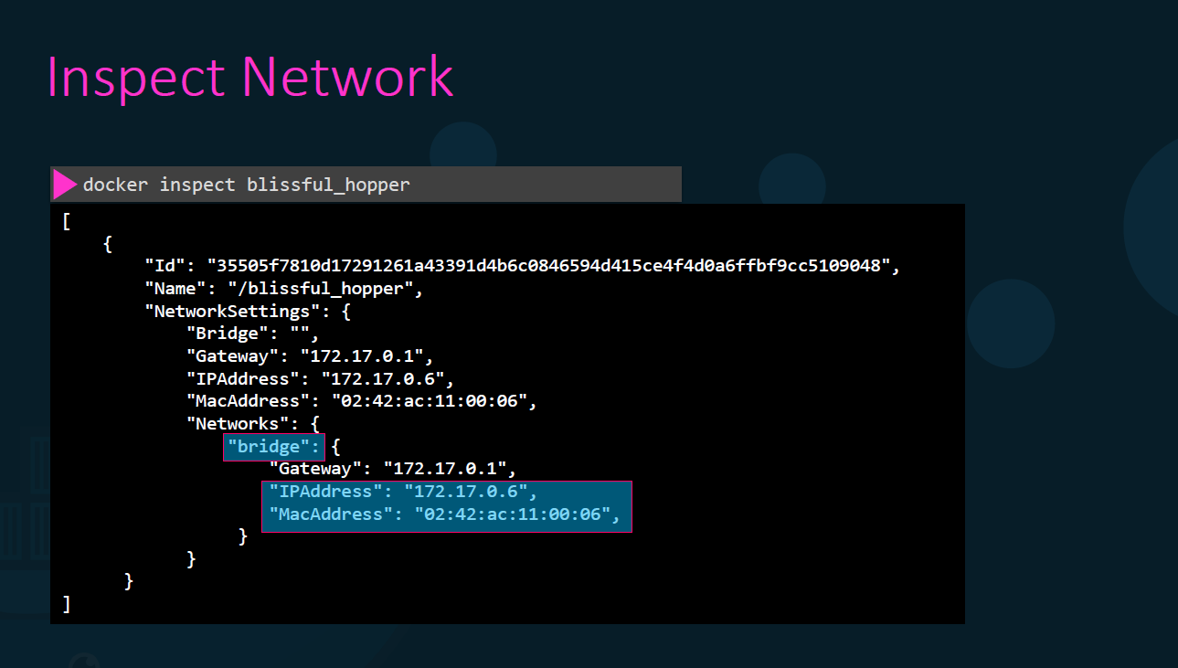

Slide 51
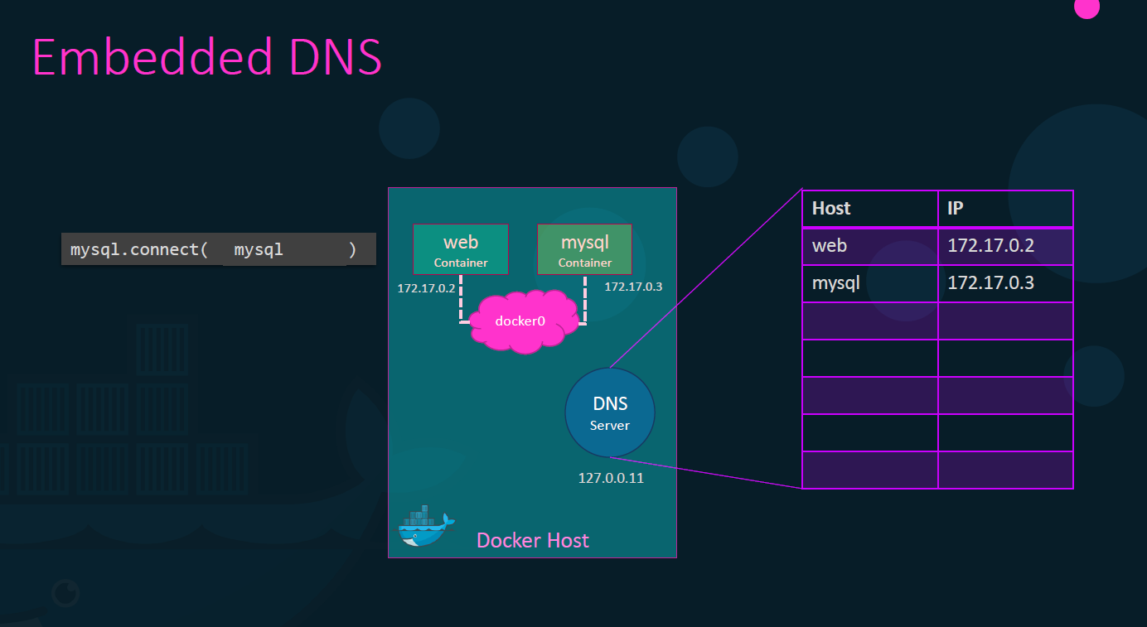
Notes:
2 different containers communicate internally using the private ip address of the container ,but it is not ideal way instead docker ip changes each time when system reboots Uses the container name example mysql to connect to the dbase. Since we have an inbuilt DNS server configured inside the docker host .which will be 127.0.0.11.
So ,how does docker implement networking ? Whats the tech behind it ? How are the containers isolated within the host? docker users network ,it creates an separate namespace, each container users virtual ethernet pairs to connect containers together .

Slide 52
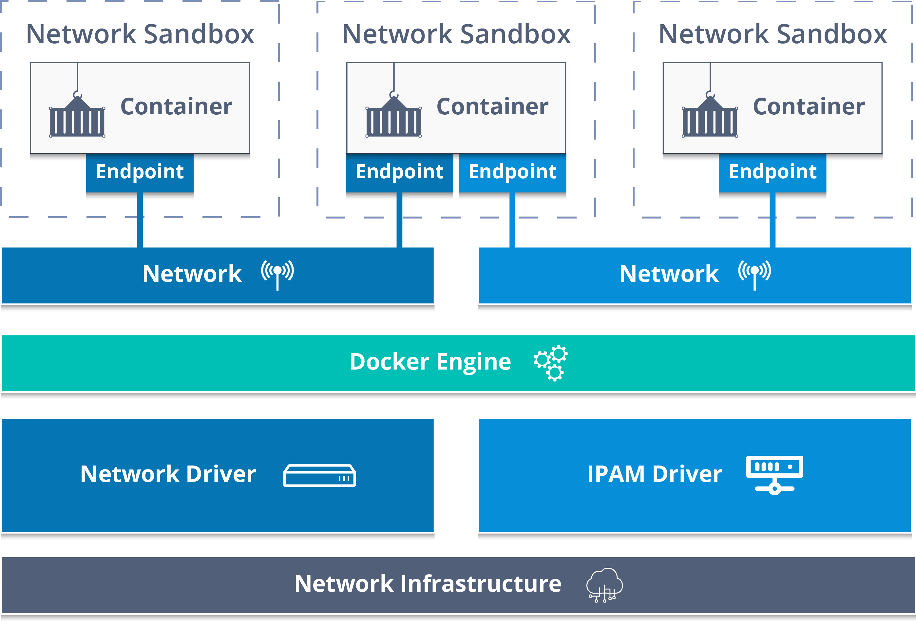
Notes:
Docker Network :
https://www.docker.com/blog/understanding-docker-networking-drivers-use-cases/
https://docs.docker.com/network/
docker network ls
docker network --help
docker network ls -f driver=bridge
docker network ls --format "{{.ID}}: {{.Driver}}"
docker network inspect "networkid"
docker network create "networkname"
docker network create -d bridge "networkname“
docker network rm “networkname”
docker network connect "networkname" "containername"
docker container run -d --name "nameofcontainer" --network "networkname" image
docker network disconnect "networkname" "containername“
Docker exec –it nginx1 bash
apt-get update
apt-get install iputils-ping
docker exec -it “nginx2" ping “nginx3"

Slide 53
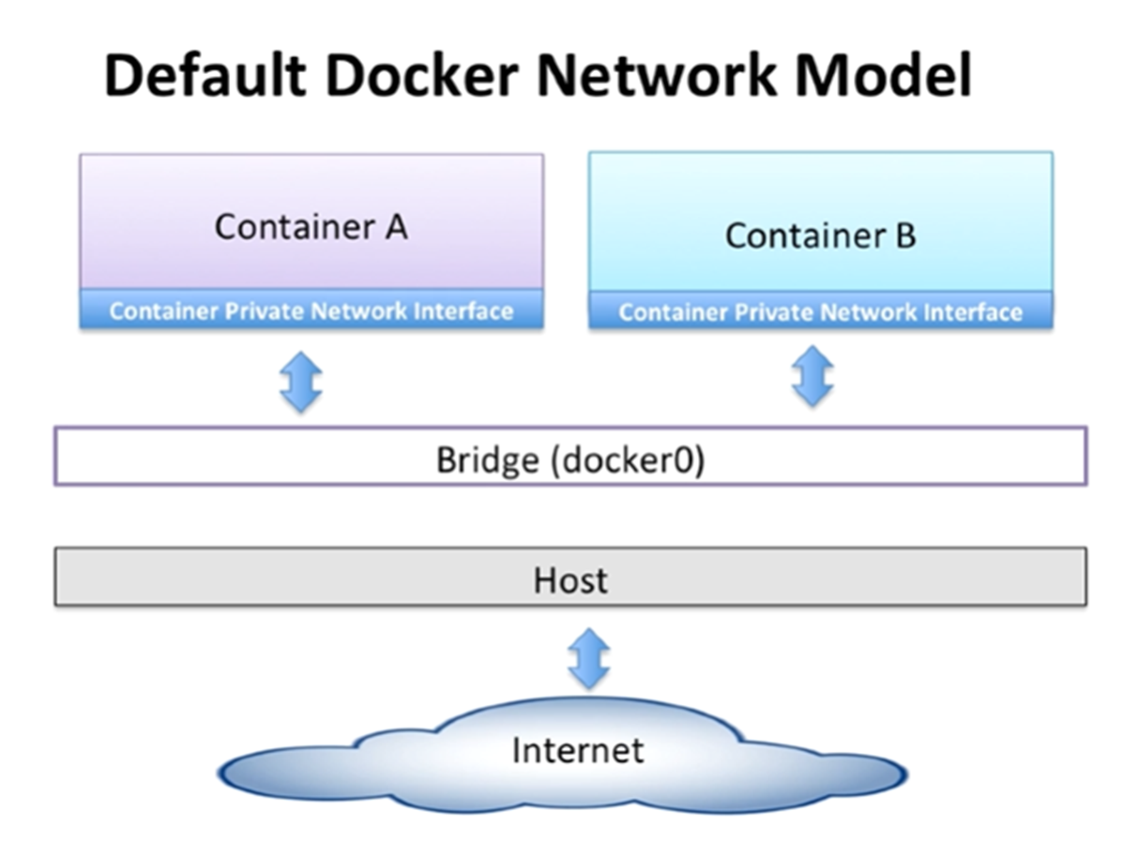
Notes:
Docker has a built in DNS server that helps the containers to resolve each other using the container name.
Bridge
None
Host Built in DNS server always runs at addr 127.0.0.11.

Slide 54


Slide 55


Slide 56

Notes:
Volumes : Volumes are stored in a part of the host filesystem which is managed by Docker.
eg: docker container run -d - -name mysql –e MYSQL_ALLOW_EMPTY_PASSWORD=True -v mysql-db:/var/lib/mysql mysql
eg: Run My SQL with named Volume
docker container run -d - -name mysql –e MYSQL_ALLOW_EMPTY_PASSWORD=True - -mount source=mysql-db, target=/var/lib/mysql mysql
Bind mounts may be stored anywhere on the host system and non-docker processes on the Docker host or a Docker container can modify them at any time, but it can’t be use in DockerFile.
Eg : docker container run -d - -name nginx - -mount type=bind, source=$ (pwd),target=/app nginx
docker pull -- > docker inspect -- >

Slide 57

Notes:
Volumes : Volumes are stored in a part of the host filesystem which is managed by Docker.
eg: docker container run -d - -name mysql –e MYSQL_ALLOW_EMPTY_PASSWORD=True -v mysql-db:/var/lib/mysql mysql
eg: Run My SQL with named Volume
docker container run -d - -name mysql –e MYSQL_ALLOW_EMPTY_PASSWORD=True - -mount source=mysql-db, target=/var/lib/mysql mysql
Bind mounts may be stored anywhere on the host system and non-docker processes on the Docker host or a Docker container can modify them at any time, but it can’t be use in DockerFile.
Eg : docker container run -d - -name nginx - -mount type=bind, source=$ (pwd),target=/app nginx
docker pull -- > docker inspect -- >

Slide 58

Notes:
Volumes : Volumes are stored in a part of the host filesystem which is managed by Docker.
eg: docker container run -d - -name mysql –e MYSQL_ALLOW_EMPTY_PASSWORD=True -v mysql-db:/var/lib/mysql mysql
eg: Run My SQL with named Volume
docker container run -d - -name mysql –e MYSQL_ALLOW_EMPTY_PASSWORD=True - -mount source=mysql-db, target=/var/lib/mysql mysql
Bind mounts may be stored anywhere on the host system and non-docker processes on the Docker host or a Docker container can modify them at any time, but it can’t be use in DockerFile.
Eg : docker container run -d - -name nginx - -mount type=bind, source=$ (pwd),target=/app nginx
docker pull -- > docker inspect -- >

Slide 59

Notes:
Volumes : Volumes are stored in a part of the host filesystem which is managed by Docker.
eg: docker container run -d - -name mysql –e MYSQL_ALLOW_EMPTY_PASSWORD=True -v mysql-db:/var/lib/mysql mysql
eg: Run My SQL with named Volume
docker container run -d - -name mysql –e MYSQL_ALLOW_EMPTY_PASSWORD=True - -mount source=mysql-db, target=/var/lib/mysql mysql
Bind mounts may be stored anywhere on the host system and non-docker processes on the Docker host or a Docker container can modify them at any time, but it can’t be use in DockerFile.
Eg : docker container run -d - -name nginx - -mount type=bind, source=$ (pwd),target=/app nginx
docker pull -- > docker inspect -- >

Slide 60

Data Persistence
Notes:
Volumes : Volumes are stored in a part of the host filesystem which is managed by Docker.
eg: docker container run -d - -name mysql –e MYSQL_ALLOW_EMPTY_PASSWORD=True -v mysql-db:/var/lib/mysql mysql
eg: Run My SQL with named Volume
docker container run -d - -name mysql –e MYSQL_ALLOW_EMPTY_PASSWORD=True - -mount source=mysql-db, target=/var/lib/mysql mysql
Bind mounts may be stored anywhere on the host system and non-docker processes on the Docker host or a Docker container can modify them at any time, but it can’t be use in DockerFile.
Eg : docker container run -d - -name nginx - -mount type=bind, source=$ (pwd),target=/app nginx
docker pull -- > docker inspect -- >

Slide 61


Slide 62


Slide 63

Notes:
Volumes : Volumes are stored in a part of the host filesystem which is managed by Docker.
eg: docker container run -d - -name mysql –e MYSQL_ALLOW_EMPTY_PASSWORD=True -v mysql-db:/var/lib/mysql mysql
eg: Run My SQL with named Volume
docker container run -d - -name mysql –e MYSQL_ALLOW_EMPTY_PASSWORD=True - -mount source=mysql-db, target=/var/lib/mysql mysql
Bind mounts may be stored anywhere on the host system and non-docker processes on the Docker host or a Docker container can modify them at any time, but it can’t be use in DockerFile.
Eg : docker container run -d - -name nginx - -mount type=bind, source=$ (pwd),target=/app nginx
docker pull -- > docker inspect -- >

Slide 64


Slide 65



Notes:
https://docs.docker.com/compose/wordpress/
nano docker-compose.yaml
docker-compose up –d
RUN commands always executes in a new layer and creates a new image layer. Eg: RUN apt-get install mysql , it is often used for installing software packages and applications.
CMD commands allows to sets default command and/or parameter. This will be executed if you run a particular container without specifying some command, which can be overwritten from command line when docker container runs.
ENTRYPOINT looks similar to CMD , however it configures a container that will run as an executable form. If you want to run a container with the condition that a particular command is always executed, use ENTRYPOINT.
https://github.com/vikas99341/Docker-Compose-nodeJs-MongoDB-Nginx--.git
Dockerfile:
=======
FROM alpine
CMD echo “Hello World ”
docker build –t <name> . == > docker run –it <name> == > docker run –it <name> sh
Dockerfile:
=======
FROM alpine
ENTRYPOINT [“/bin/echo”, “Hello”]
CMD [“World ”]
docker build –t <name> . == > docker run –it <name> vikas

Slide 66












Notes:
Earlier we saw how to deploy a stack using docker run command. You could use the docker run command if you wanted to deploy a test container of some kind. Instead of running separate dockerrun commands a better way to do this is to define your configuration in a docker-compose file. A docker compose file is a file in YAML format were you define the different services involved in your application such as web, database, messaging, orchestration etc. Once the file is defined, running the docker-compose up command will bring up the stack.
45

Slide 67



Slide 68


Slide 69


Slide 70


Slide 71


Slide 72


Slide 73


Slide 74
Thank You.

